Slide 1
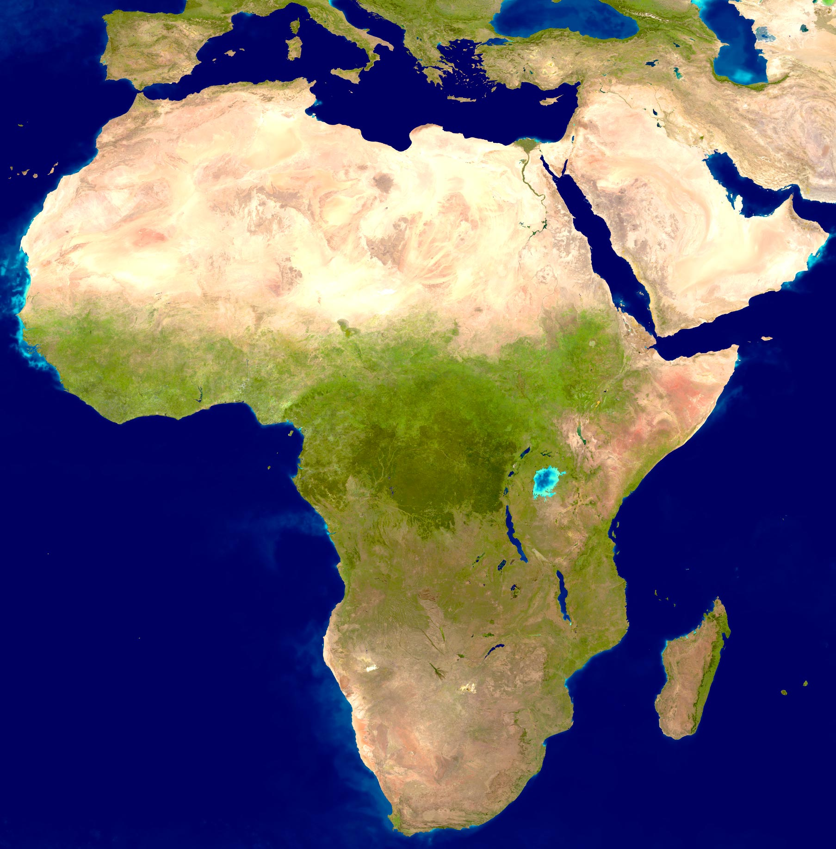
AFRICA

Slide 2
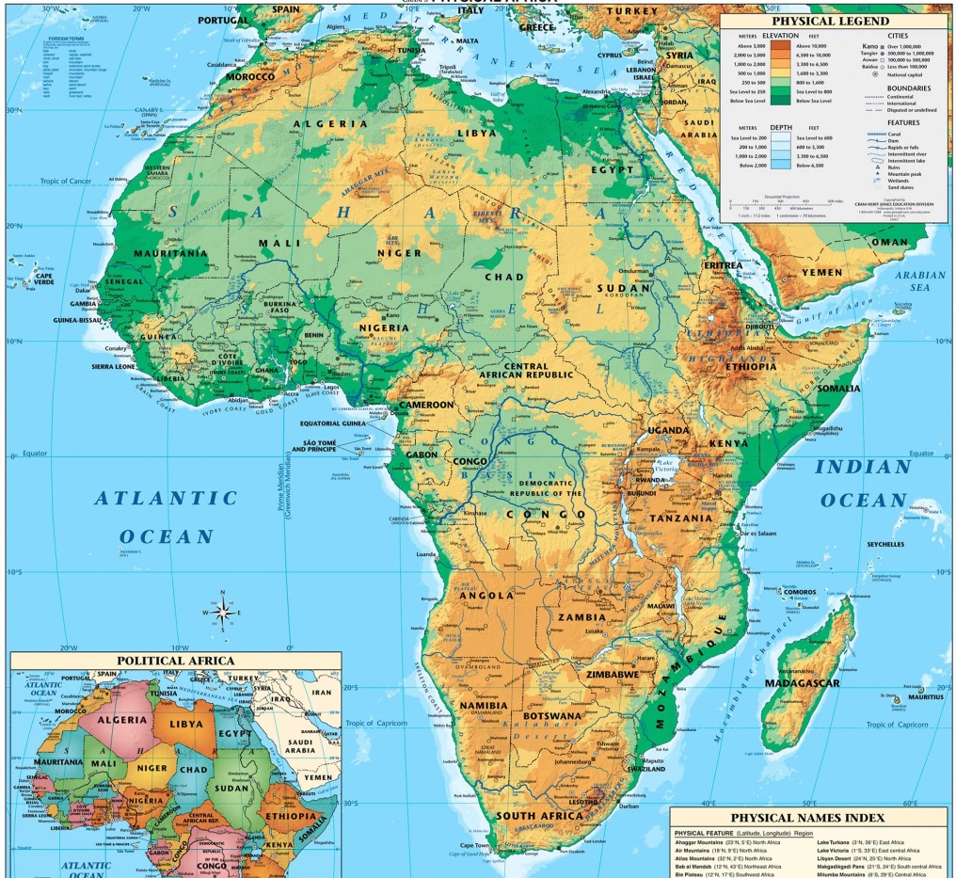
v
ATLAS Mountains
v
Nilo River
Ahaggar
Tibesti
SÁHARA
Senegal River
Niger River
Niger
Basin
Chad
Lake
Somalia Peninsula
Grandes Lagos
Rift Valley
Gulf of Guinea
Congo
Basin
Vitoria
Lake
R. Congo
Zambeze River
Limpopo River
Madagascar
KALAHARI
Drakensberg Mountains
Orange River
Cape of Good Hope

