Slide 1
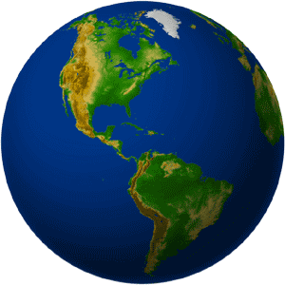
America

Slide 2
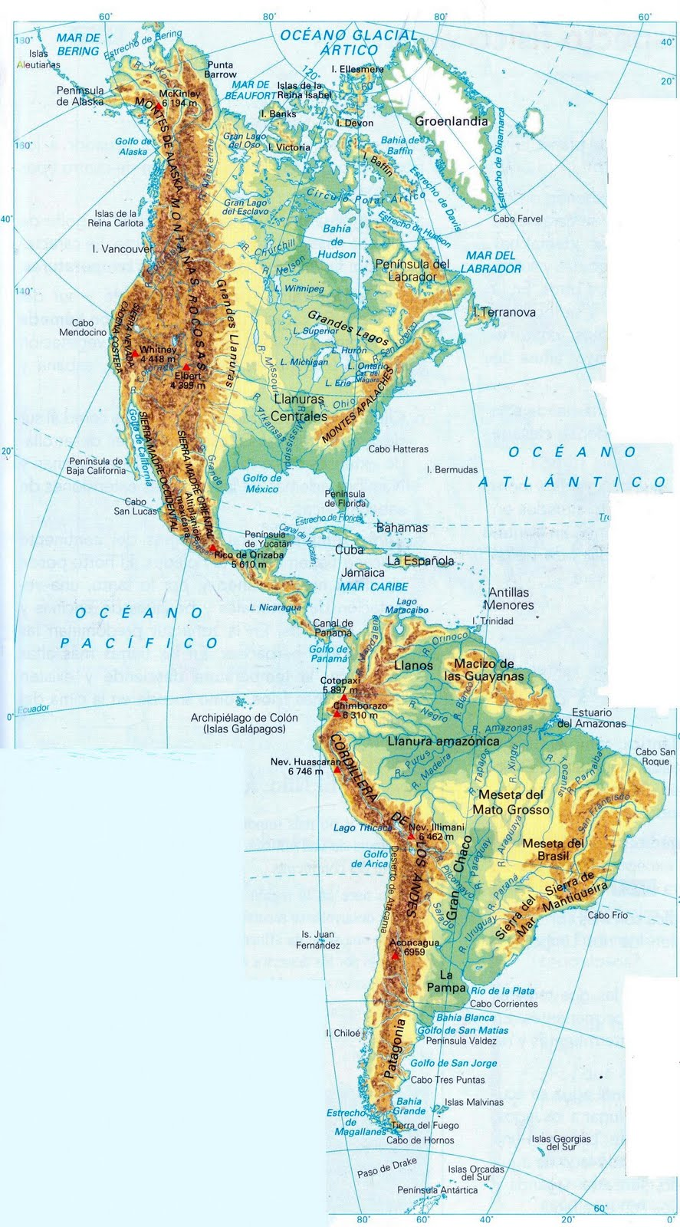
Greenland
River Yukón
Rocky Mountains
Hudson Bay
Labrador Peninsula
River Colorado
R. Mississippi
Great Lakes
Appalachian Mountains
Gulf of Mexico
Florida Peninsula
Antilles
Yucatan Peninsula
Lake Maracaibo
Amazon River
Bolivian altiplano
Mato Grosso Plateau
Andes
Mountains
L.ake Titicaca

