Slide 1
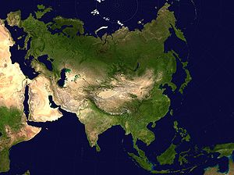
ASIA

Slide 2
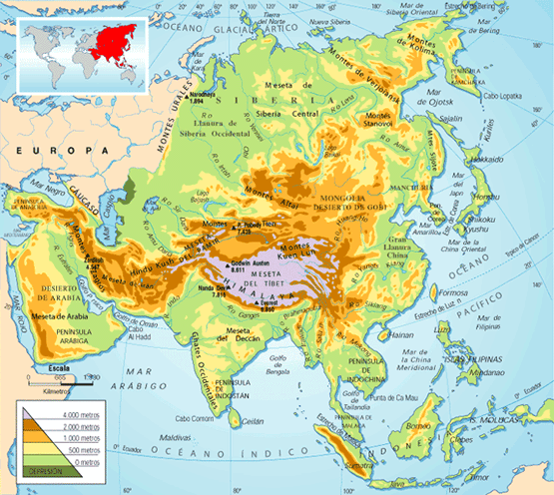
River Lena
Siberia
River Yenisey
River Ob
Lake Baikal
Japanese
archipelago
Caspian
Sea
Aral Sea
Anatolian
Peninsula
Altay Mountains
River Huang Ho
Tien Shan Mountains
Gobi Desert
Dead sea
River Yangtze
River Indo
Tibetan plateau
Persian Gulf
Himalayas
Arabiean
Peninsula
River Ganges
Philippine Islands
Indian Peninsula
Bengal bay
Indochinese peninsula
Indonesia

