Slide 1
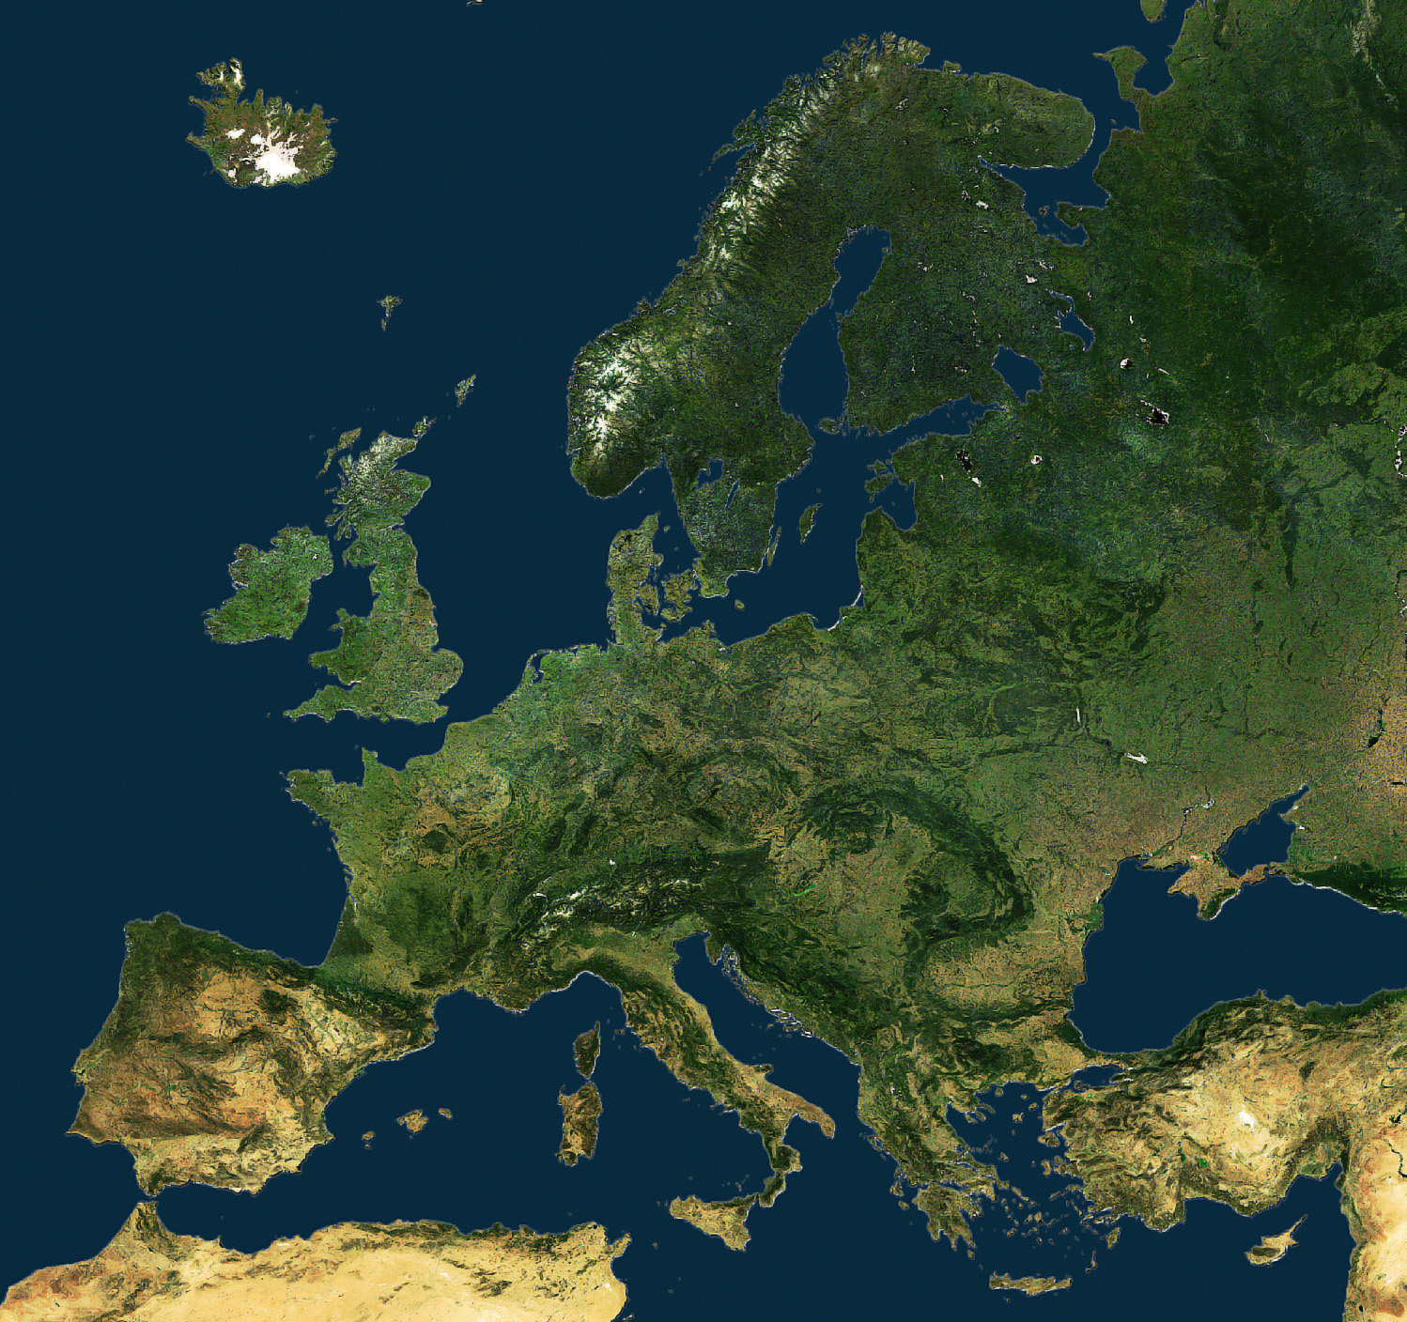
EUROPE

Slide 2
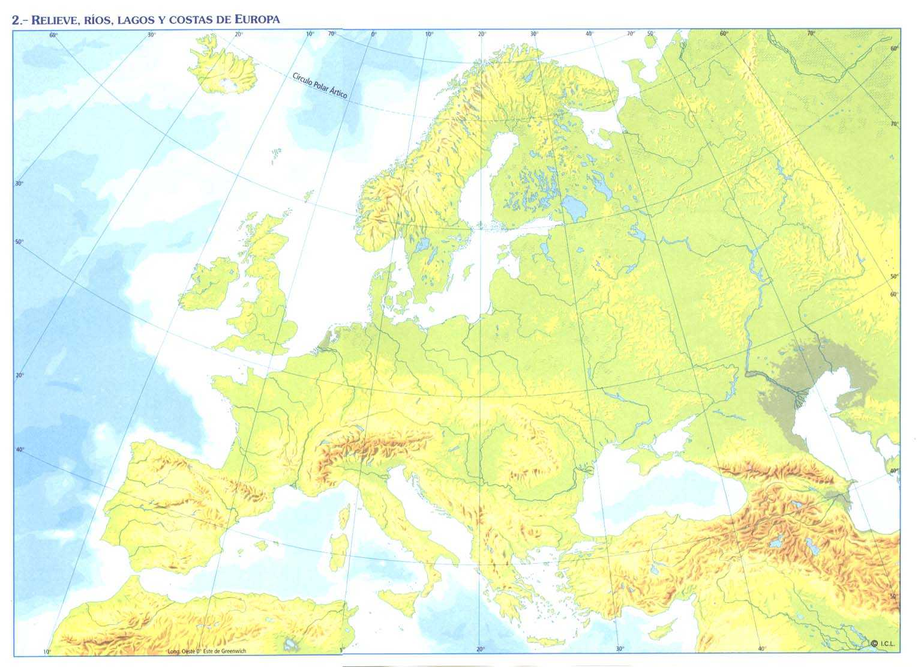
Iceland
Norwegian Sea
Kjolen Mountains
Scandinavian P.
Ural Mountains
British Isles
Baltic Sea
River Volga
North Sea
North European Plains
Thames
River Elbe
River Seine
Alps
Carpathian Mts
Caucasus
Pyrenees
River Po
Ebro
River Danube
Black Sea
Tajo
Balkans
Italian P.
Iberian Peninsula
Adriatic Sea
Strait of Gibraltar
Balearic Islands
Balcan Peninsula

