Slide 1
How hard was life for medieval people in town and country?
To know how aspects of medieval life are interpreted in modern films
To review your knowledge of this unit and highlight key findings
To use your knowledge of the Middle Ages in a structured report

Slide 2
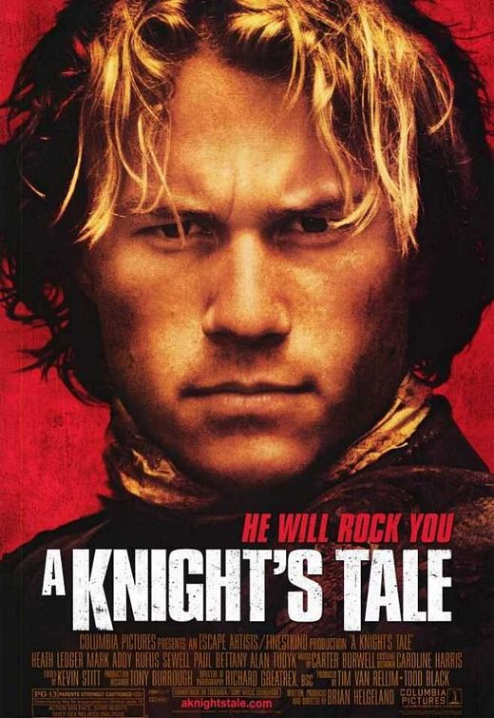
Watch the following clip from this medieval film.
What does this tell us about people in the Middle Ages?

Slide 3
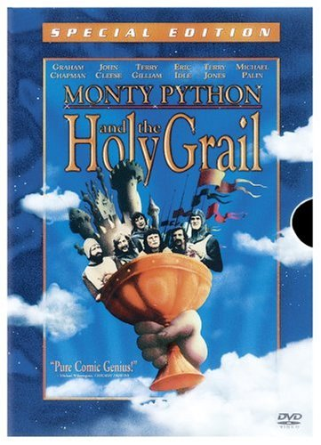
Watch the following clip from this medieval film.
What does this tell us about people in the Middle Ages?

Slide 4
The Middle Ages: 'What was it like for ordinary people?
Are you confused about the Middle Ages?
What was it like for ordinary people?
In some films you see jolly people enjoying watching jousting, eating and drinking.
In others, the poor are treated like slaves by the rich.
Which of these interpretations is right?

Slide 5



You have been hired as researchers by a film director who wants to make an adventure film set in the Middle Ages. She wants to show the reality of life in the medieval town and country. Details must be really accurate - she has been accused by critics of being careless over period detail in her other films.
Produce a brief report answering her questions and providing background information for one scene set in either a village or a town. Include details, e.g. the types of people who might be found in this scene, the work or other activities they might be doing, the clothes they might be wearing, and details on what the buildings were like.

Slide 6
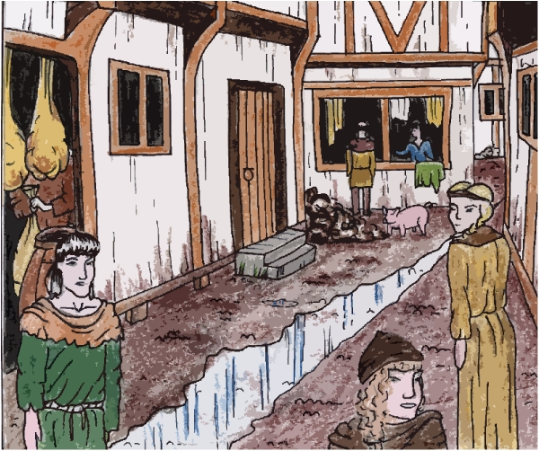
A Typical Town Street
rubbish thrown into the street
Buildings are timber framed
Pigs eating rubbish in the street
Upper storey overhangs to maximise space
Buildings are closely packed - fire risk
Sewage in the middle of the street
rats
Shops in front room

Slide 7
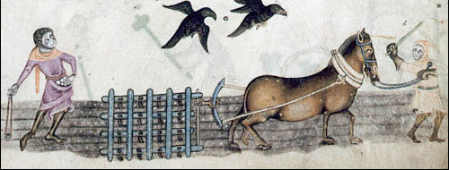
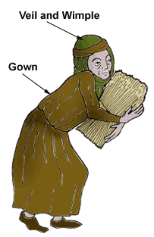
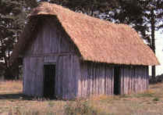
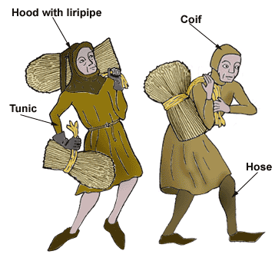
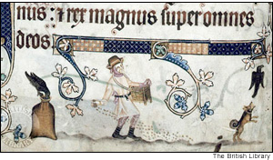
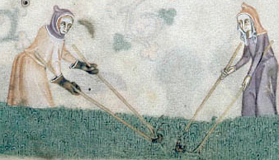
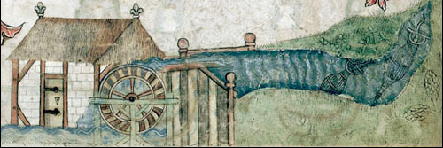
A Typical Village Scene
  Ploughing
I must make sure I harvest enough for my family as well as for my Lord and the Church.
  Peasant clothing
Houses are made of wood, mud and straw
  Sowing
  Weeding
  Water Mill

Slide 8
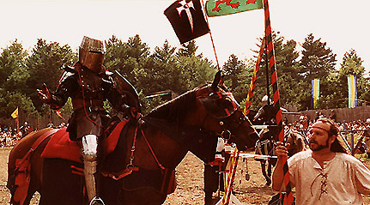
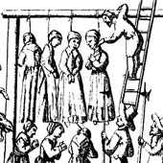
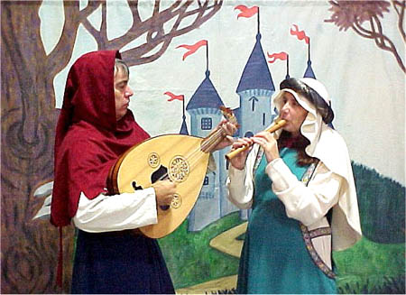
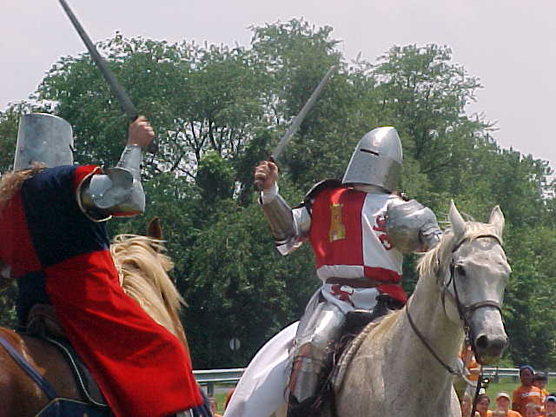
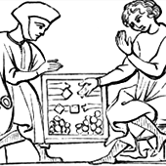
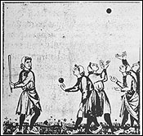
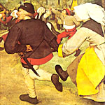
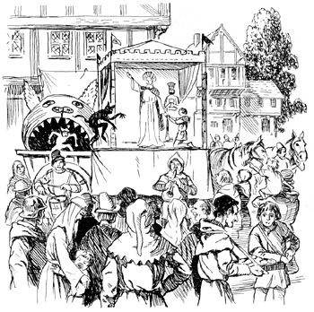
Entertainment
  Jousting
  Watching Punishments
  Board Games
  Sword Fights
  Ball Games
  Plays
  Dancing

Slide 9
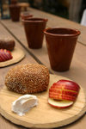
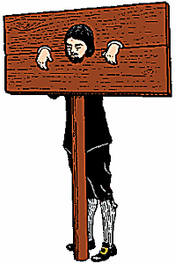
Medieval Food
Black bread
Beer
Eggs
Cheese v
Beans
Corn
Soup
Stew
Pottage
Bacon
Cabbage
Cider
Dogs
A butcher was punished like this for selling rotten meat.
Large towns had takeaway food selling hot sheep’s feet and little birds!
No one could eat meat on a Friday
Some bakers cheated adding sand or cobwebs to bread!

Slide 10


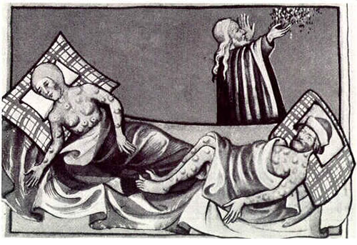
The Black Death
25 million people died in just under five years between 1347 and 1352.

Slide 11
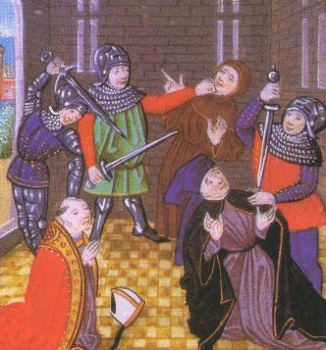
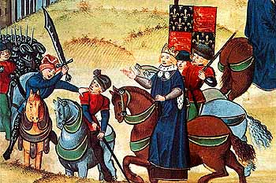
The Peasants Revolt
The peasants did not like being slaves and paying such high taxes. They decided to go and talk to the King to ask him to make things fairer. All leaders of the revolt were hanged.

Slide 12
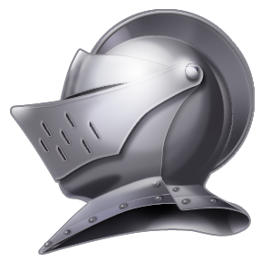
Things to think about
Was life always hard for medieval peasants?
Was life any better in a medieval town?
Why was the Black Death so terrifying?
Why was there a Peasants' Revolt in 1381?

Slide 13
The Middle Ages: 'What was it like for ordinary people?
YOU DECIDE!
Which interpretation are you going to choose?
  Always terrible.
  Town life was easy
  Sometimes peasants had a lot of fun
  Always fun and exciting!
  Village life was hard
  Sometimes peasants had a little fun

Slide 14
Levels
You have to say why you choose the interpretation you did?
The more explanation you include the higher you level.
  Level 3 – listed
  Level 4 – described
  Level 5 – explained
  Level 6 - analysed

