Slide 1
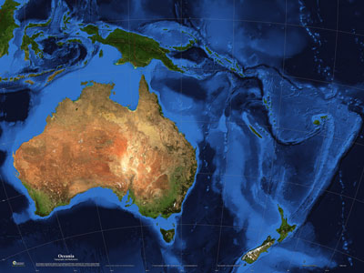
Oceanía

Slide 2
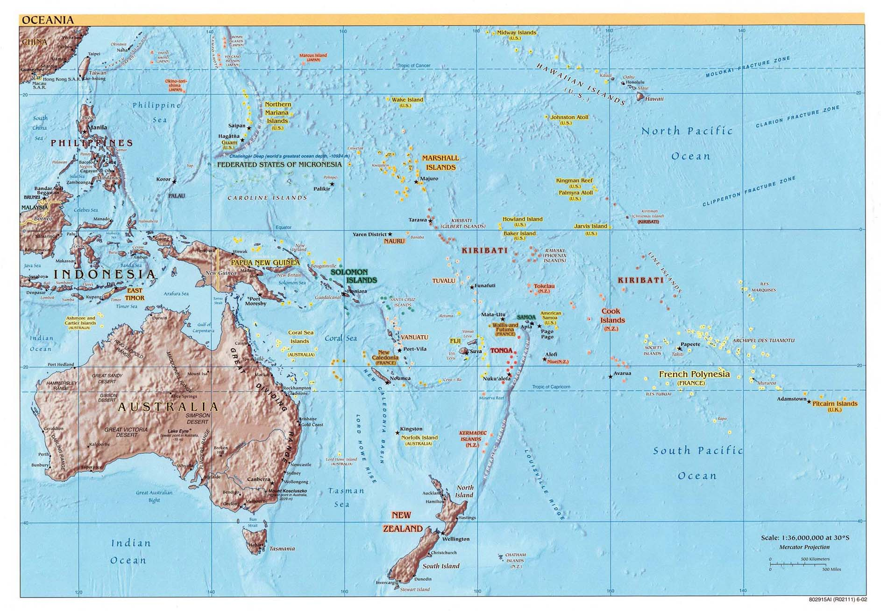
Micronesia
Polynesia
Papua New Guinea
Melanesia
Great Barrier Reef
Great Victoria Desert
Great Dividing Range
River Darling
River Murray
Australia
New Zealand

