Slide 1
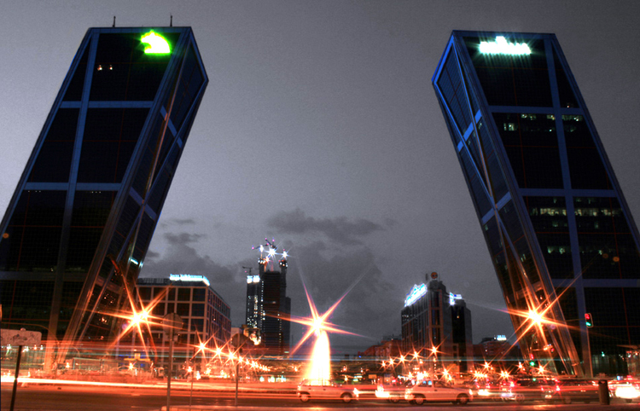
The Spanish Economy
Unit 9

Slide 2
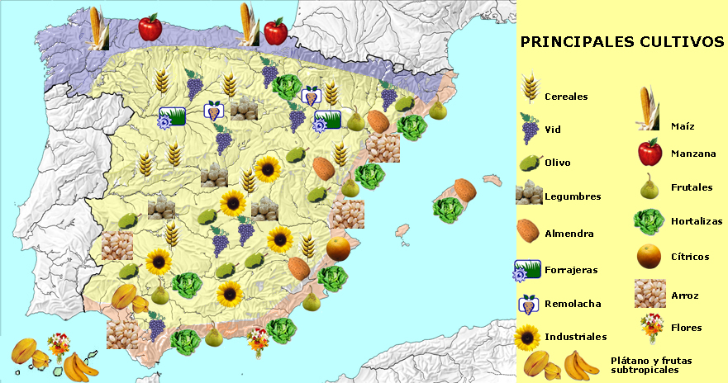
1. Agriculture in Spain
Characteristics → use of machinery, fertilisers, selected seeds and irrigation
Aim→ grow produce for sale on the market
Wide range of crops: cereals, legumes, grapes, olives, fruit, vegetables, industrial plants and fodder

Slide 3
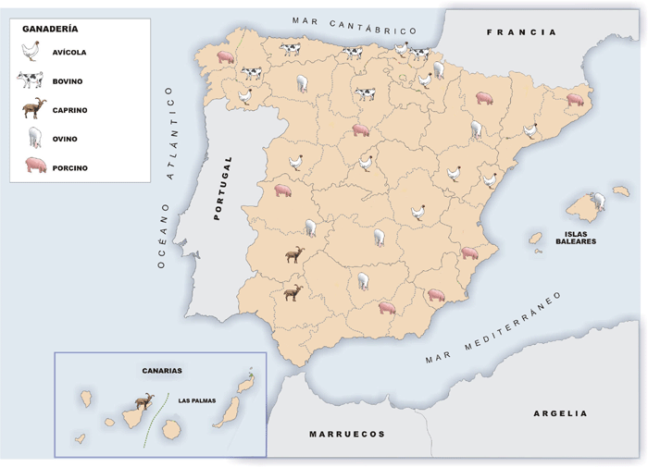
Livestock farming
Large proportion of overall agricultural production. Tends to be intensive, stabled farming.
Forestry has limited resources due to the lack of forests caused by intensive deforestation

Slide 4
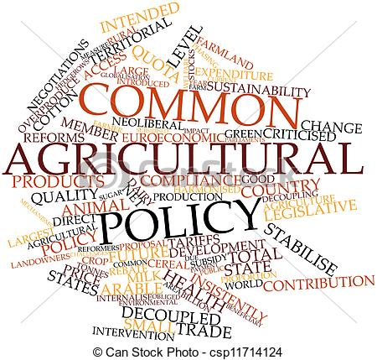
The problems in the primary sector
Problems:
Ageing population
Production of surpluses of some products
Lack of competitiveness of some small farms
Deterioration of the environment
To resolve them: different policies:
Funding rural development
Production quotas
New crops
Increase areas of forest

Slide 5
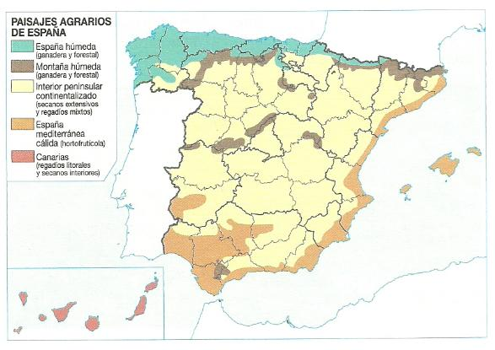
2. Spanish agricultural landscapes

Slide 6
3. Fishing activity in Spain
Characteristics → traditional, small ships, off-shore and high-seas fleet
Species caught→ fish, molluscs, crustaceans and cephalopods. Fishing production is used primarily for human consumption of fresh fish.

Slide 7
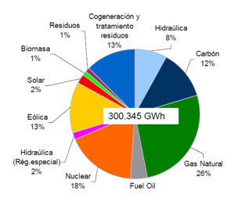
4. Spanish industry. General characteristics.
Mineral resources → mining was important until the end of the 19th century. Today is less important due to the exhaustation of this deposits.
Sources of energy → based on traditional energy sources:
.- Oil: the main source
- Natural gas
- Coal
- Hydroelectric energy: produced in river basins in the north of the Peninsula
- Nuclear energy
Alternative energy sources still account for a relatively small proportion of consumption

Slide 8
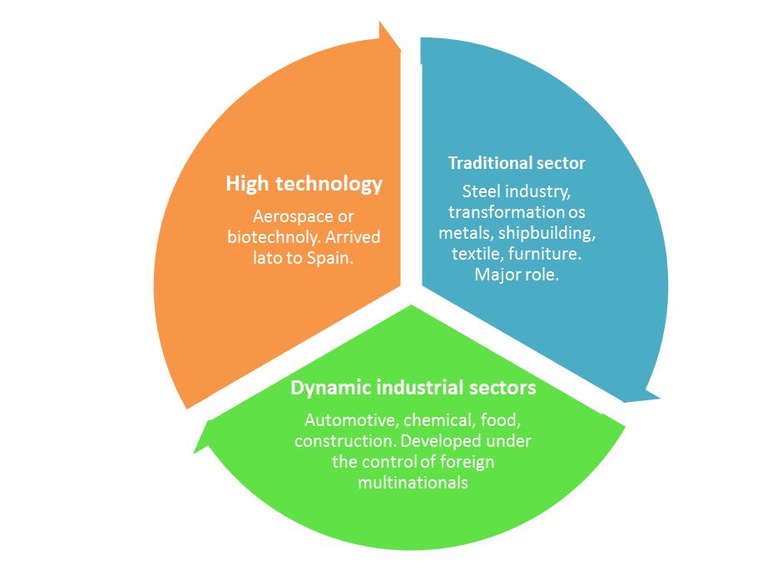
The industrial sectors

Slide 9
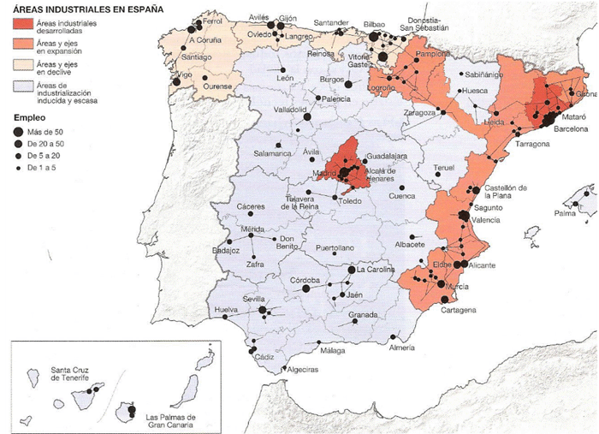
Spanish industry. Distribution and problems.

Slide 10
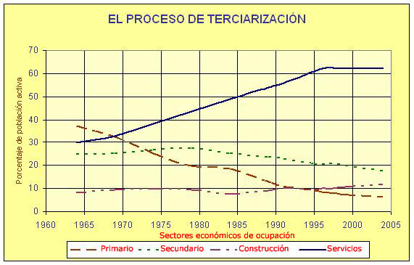
6. The tertiary sector in Spain. Commerce and transport.

Slide 11
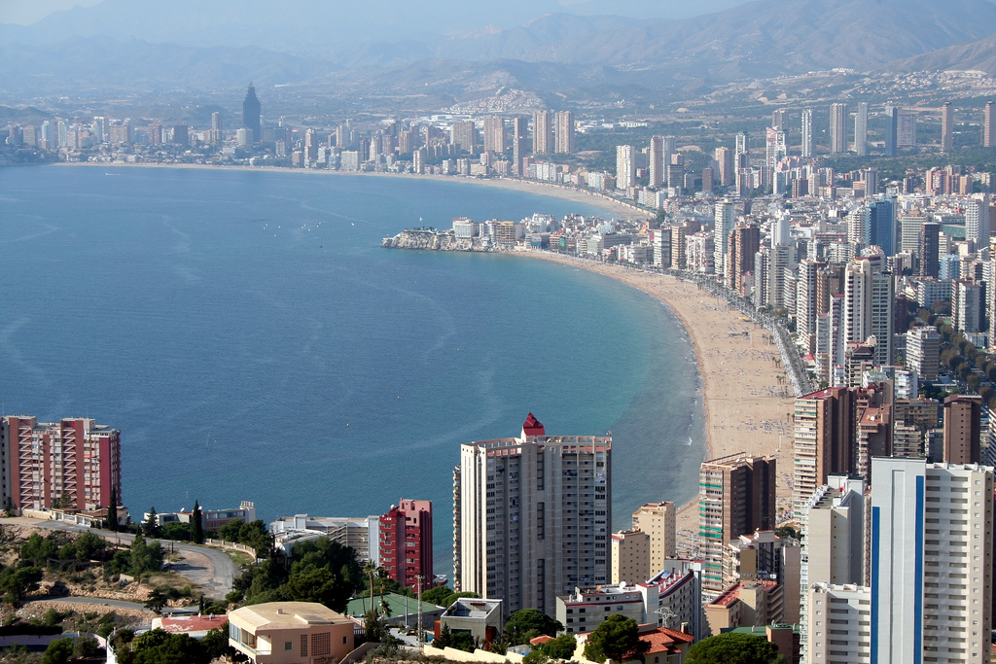
6. The tertiary sector in Spain. Tourism

