Slide 1
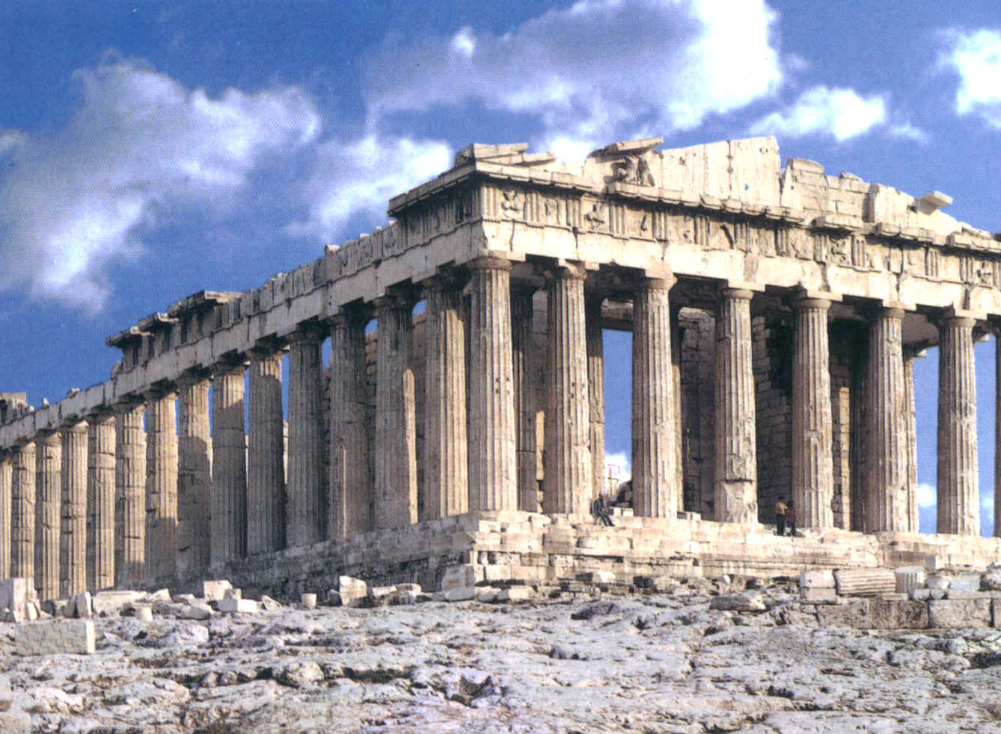
Unit 10
Ancient Greece

Slide 2
1. The greek civilization
Started in the south of the Balkan Peninsula in the Eastern Mediterranean
They also lived in many islands, and the coast of Asia Minor, which now is Turkey.
HELLAS

Slide 3
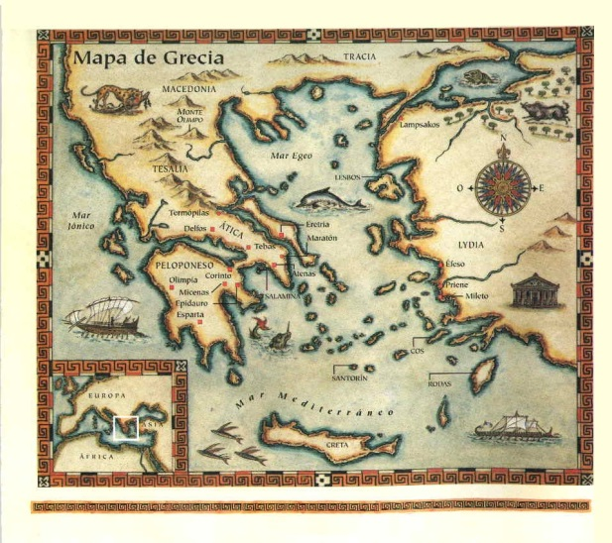
Each valley and island was an Independent State
They obtained most of their food from the Mediterranean Sea
The Greece’s history is divided in three periods.
Archaic period
Classical period
Hellenistic period
V - IV B. C
IV - I B. C
IX - VI B. C

Slide 4
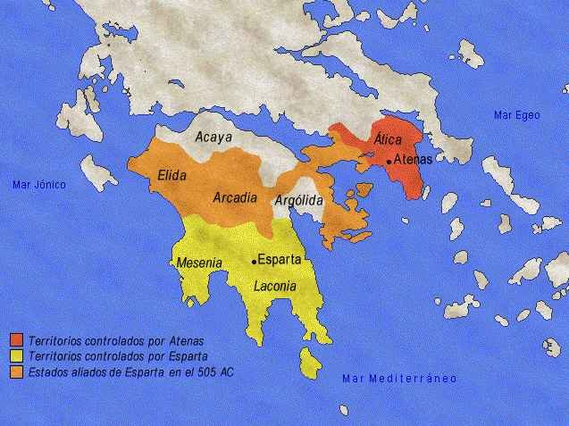
2. Archaic Period: the polis and its expansion
Polis
=
city-state
Cities with its own government, laws, army, and way of life .
At the beginning, they were ruled by a local boss, later by a privileged minority, called aristoi.
Later, in the second half of VI century B. C., the democracy appears. The citizens met regularly on assemblies to make decisions and choose their representatives.

Slide 5
The Greek expansion
VIII to VI century B.C → period of crisis
Many greeks migrated and founded colonies around the Mediterranean Sea
To the west (750-650 B.C.)
To the east (after 650 B. C.)
They mixed with other peoples
Spread Greek influence beyond its borders
Near the coast
On a hill
With water and fertile land
Independents

Slide 6
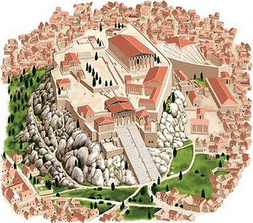
3. Classical period: Athens and Sparta
V B. C. and first half of IV B. C. → classical period. Athens and Sparta were dominant.
Athens
The Assembly or Ekklesia. The laws were prepared by a Council, or Boule.
The magistrates, carried out the assembly’s decisions.
Democratic polis
Courts of law. Chosen by drawing of lots.
Women, foreign and slaves weren’t considered as citizens

Slide 7
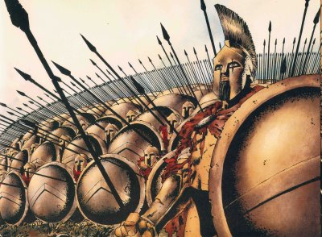
Sparta
Two kings. From different families, with military and religious power.
Gerousia. 28 elders from the more powerful families and the kings. They presented projects to the Apella
Polis devoted to war
Ephors. 5, they represented the Apella, controlled the actions of the kings and made sure the laws were obeyed.
Apella. All the citizens older than 30 years. Limited power.

Slide 8
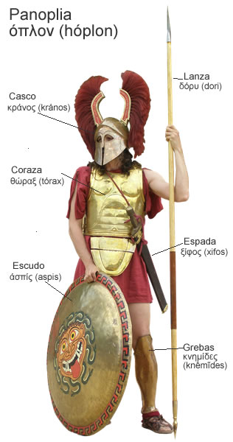
4. Classical period. A period of continual wars.
The Persian wars
The Persians, who lived in the Iranian plateau, started a territorial expansion in the 6th century.
Greeks against Persians over control of the coasts of Asia Minor.
In the 499 B. C. the polis rebelled. Athens organised an association of city states called the Delian League and sent a powerful fleet to conquer the Persians
The Persian wars
First Persian War: ended in the year 490 B. C., when the Greek soldiers,
won on the Battle of Marathon
480 B. C. the Persian king Xerxes I started the Second Persian War.
They lost in the Battle of Salamina.

Slide 9
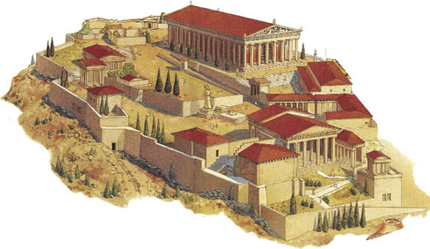
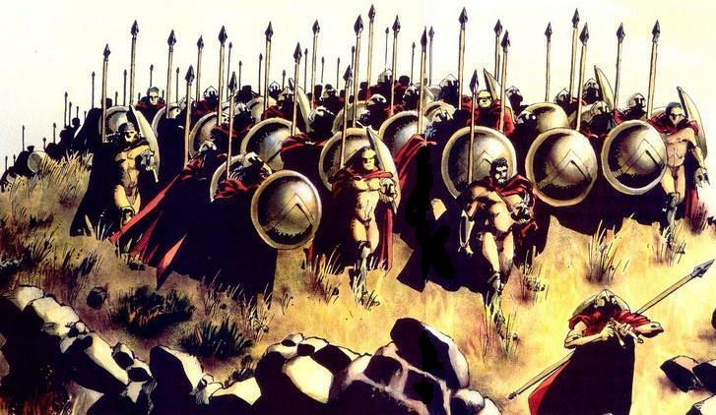
The conflict between Athens and Sparta
Athens was the richer and more influential polis
447 B. C. the Delian League was created
Peloponnesian War in 431 B. C. between supporters of Athens and Sparta
Finished in the year 404 B. C. with the victory of Sparta

Slide 10
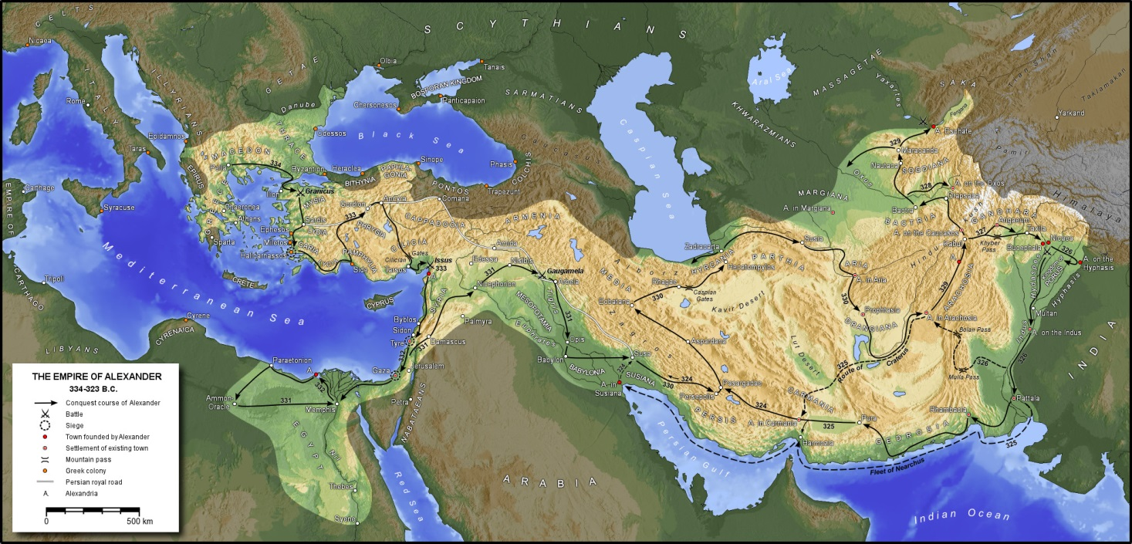
4. Alexander the Great and the Hellenistic Age
From the 4th century B.C. the kingdom of Macedonia , located to the north of Greece, began to conquer the Greek city states with Philip II
His son Alexander the Great inherited the throne
Between the years 334 and 323 B.C. he conquered the Persian Empire and Syria, Egypt and Mesopotamia.

Slide 11
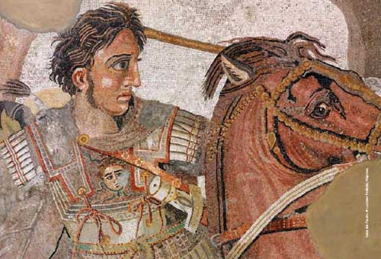
The Hellenism
He founded many cities
He spread the Greek culture
After Alexander’s death→ Hellenistic kingdoms

Slide 12
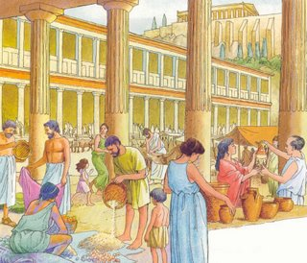
Life in Ancient Greece

Slide 13
1. A hierarchical society

Slide 14
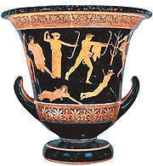
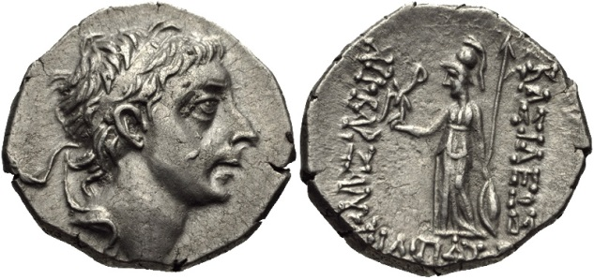
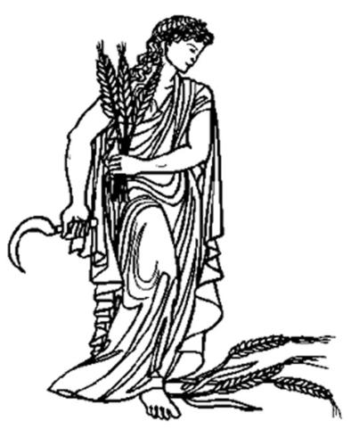
2. Economic activities
Crafts
Pottery
Leather
Textile
Trade
Local commerce
Agriculture
Long distance trade
Vines
Weath
Olives

Slide 15
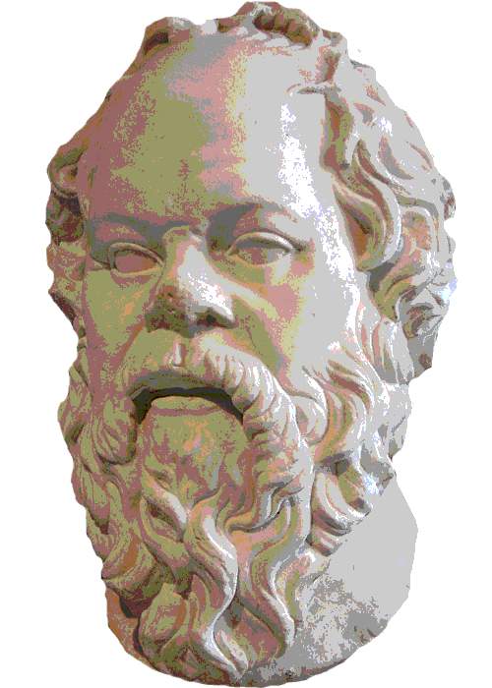
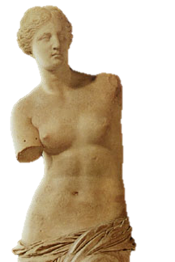
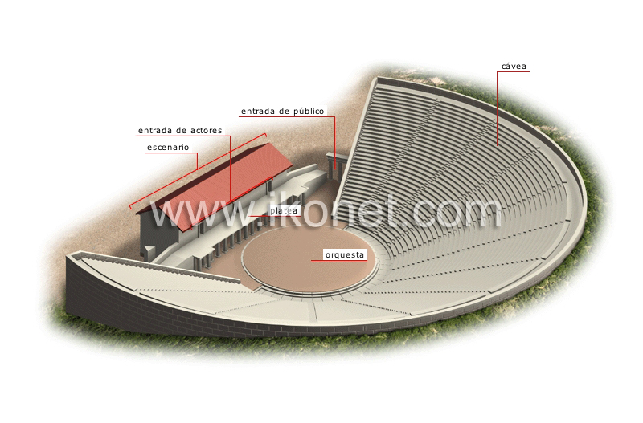
3. The greek culture
They developed a very original culture
They invented Science and Philosophy
Theatre
Myths, buildings and sculptures inspired the whole world

Slide 16
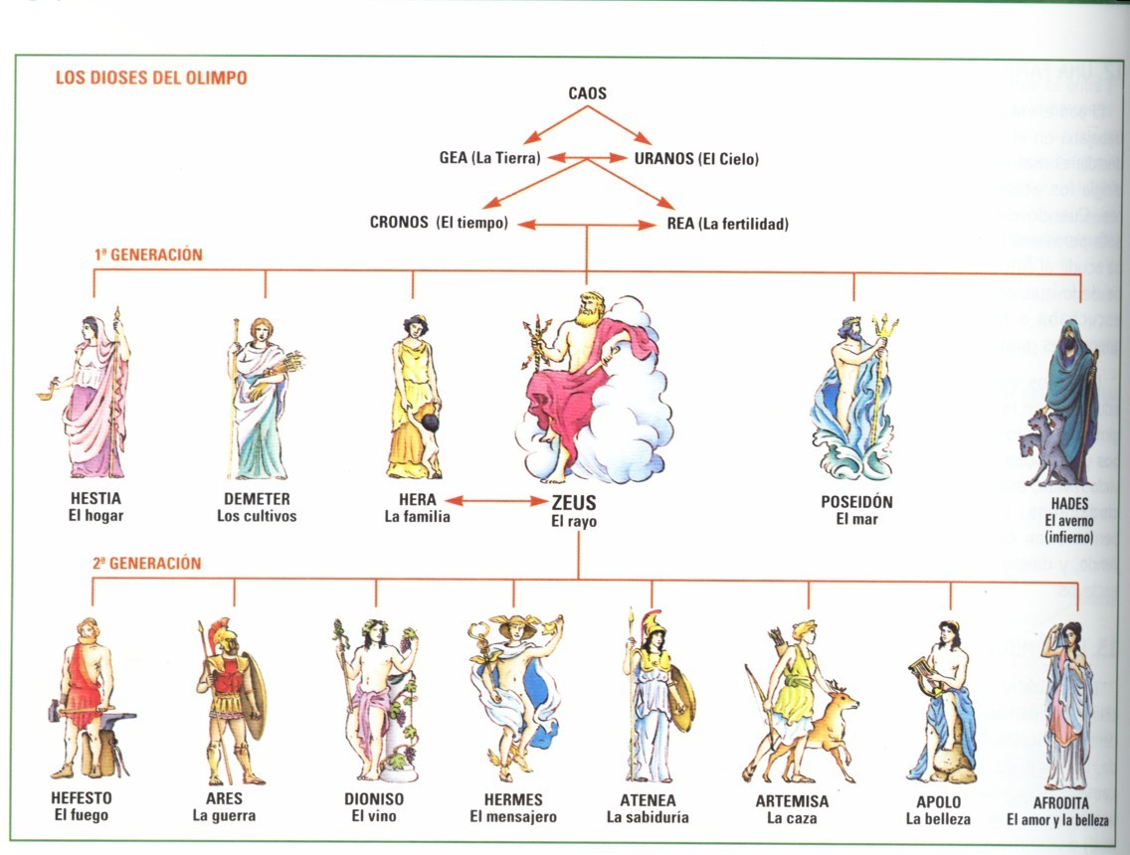
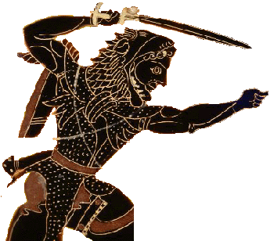
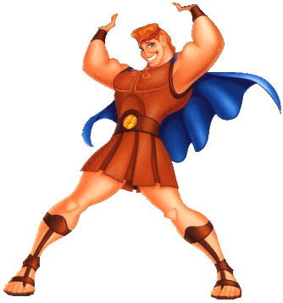
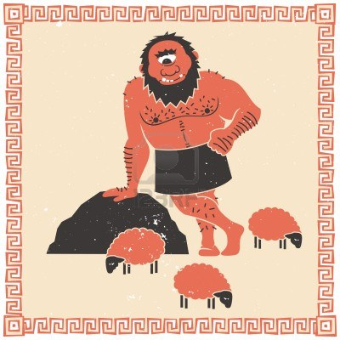
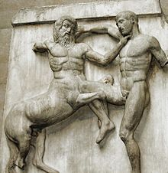
4. A relixión grega
Gods and heroes. The myths
They were polytheistic
Gods inmortals, with human look
They lived in the Olimpo, Zeus was the main god
They believed in heroes, sons of humans and gods
They belived in fantastic creatures, like centaurs or cyclopes

Slide 17
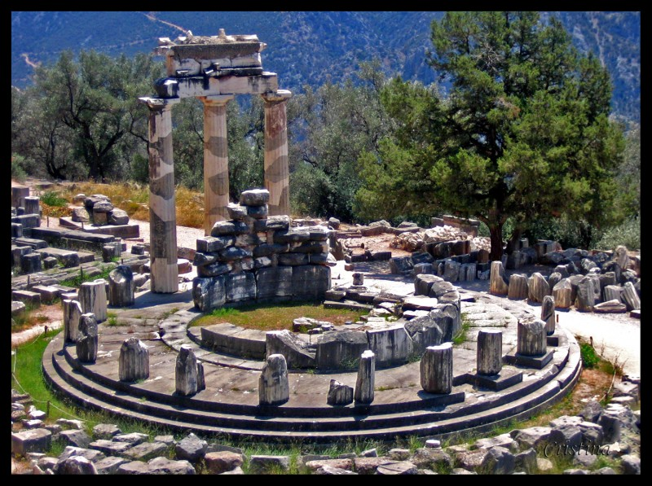
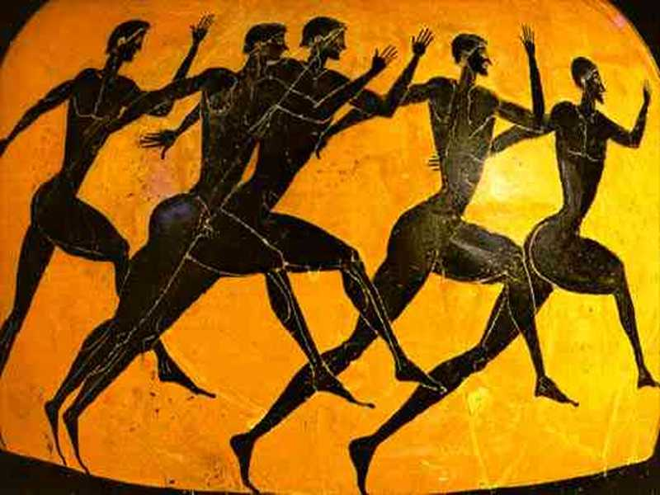
RITUALS
At home
Each city
Sanctuaries
Religious cult
Temple
Priest and priestesses
Offerings

Slide 18
5. Greek urbanism: the cities
Near the sea
Agora
Organized around the
Acropolis

Slide 19
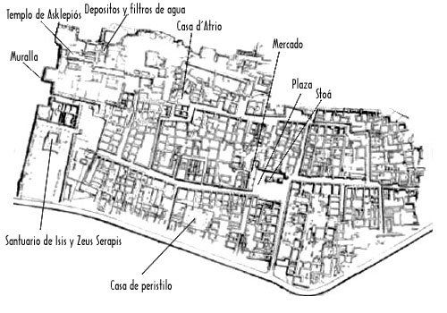
Hellenistic period → a big development
Habours
New building types

Slide 20
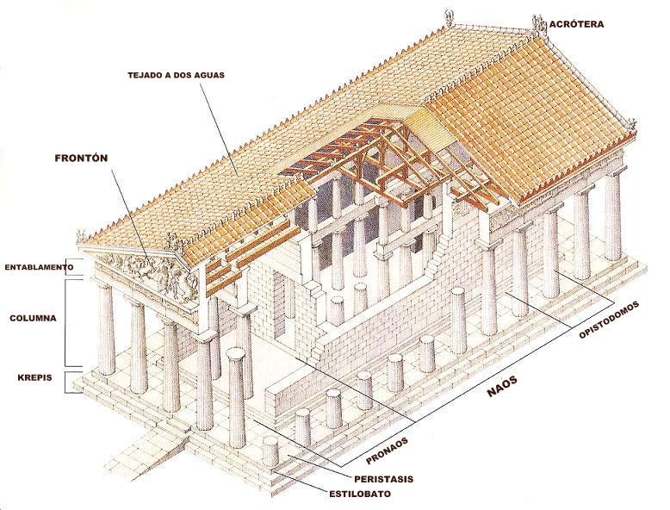
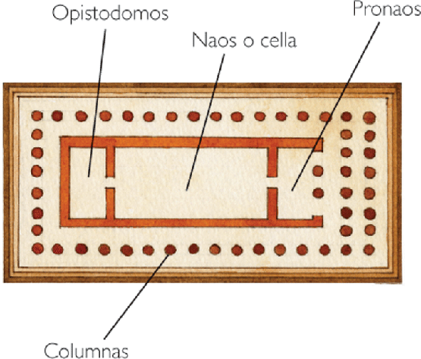
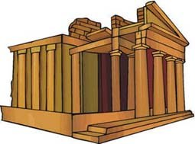
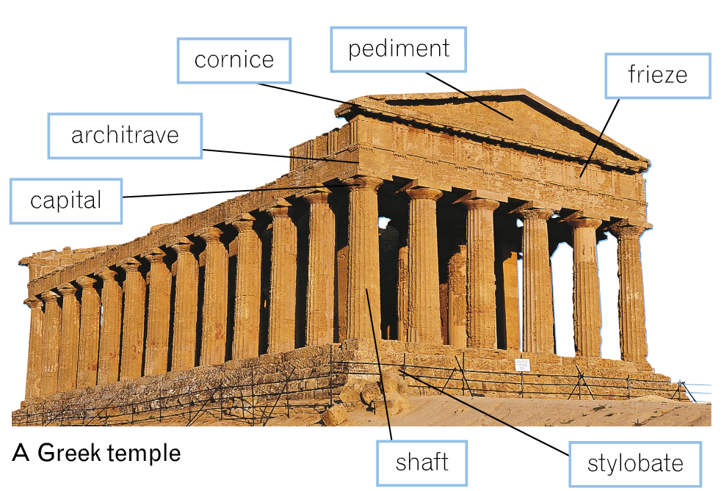
6. Architecture. Temples
White marble with colours
Rectangular
Many rooms
Lintel roof
Gable roof
Pronaos
Naos or cella
Opostidomos

Slide 21
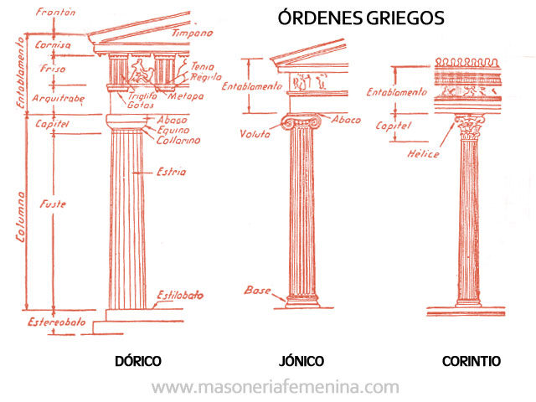
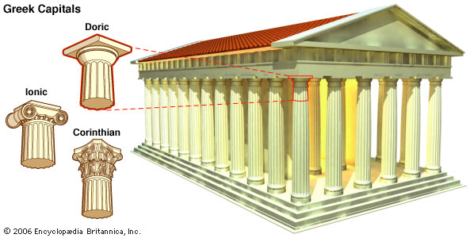
The three orders
Concerned about harmony, beauty and proportion → orders

Slide 22
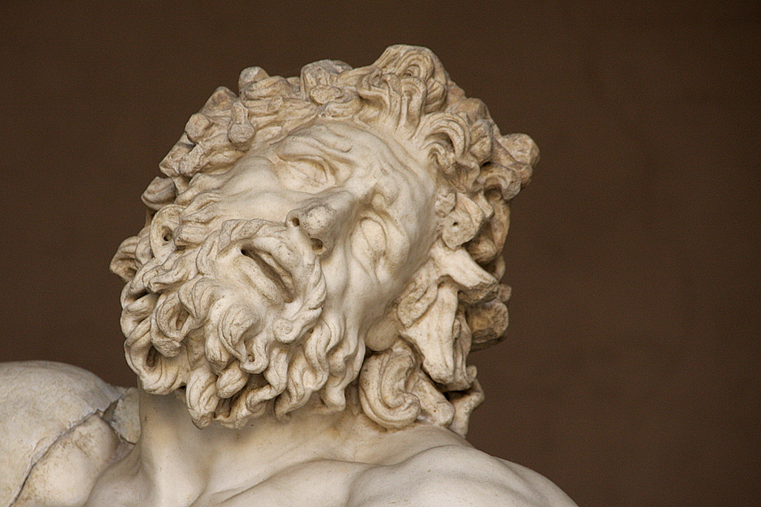
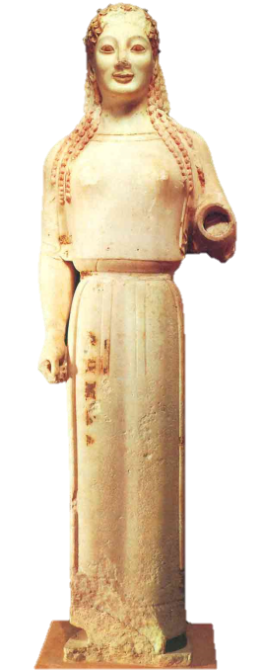
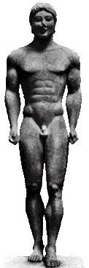
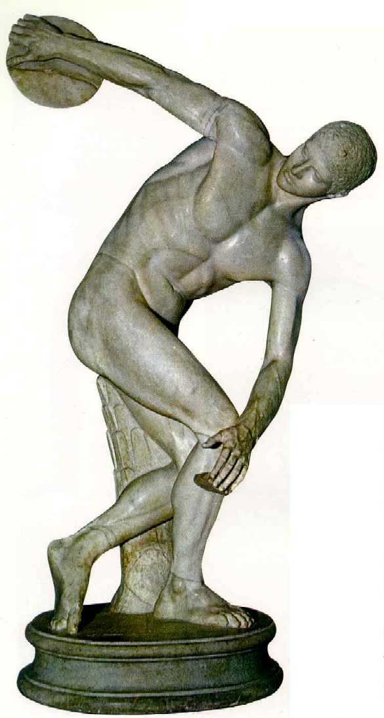
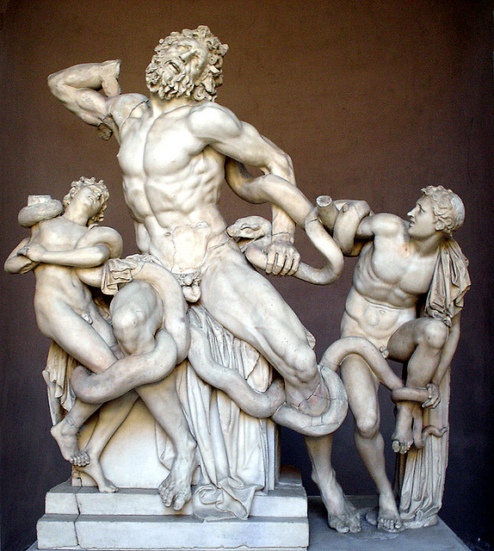
7. Sculpture
Religious function
Representing the beauty of the naked human body
Made in marble or bronze, painted with colours
Archaic period
Classical period
Hellenistic period

Slide 23
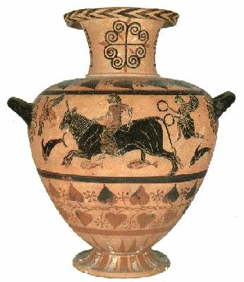
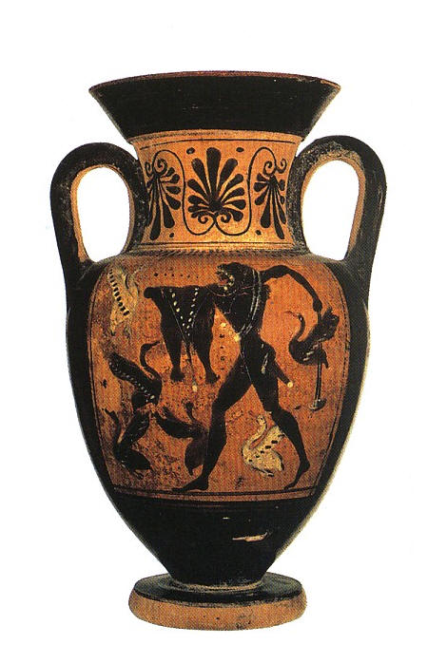
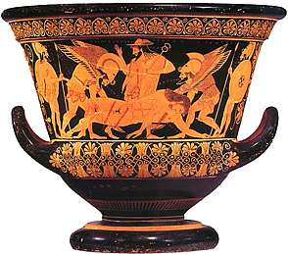
8. Pottery
Archaic period
Classical period
Hellenistic period

