Slide 1
Unit 13
Society and diversity

Slide 2
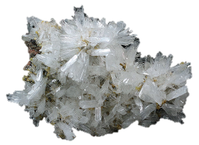
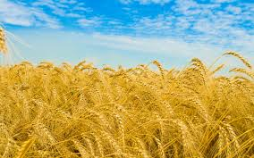
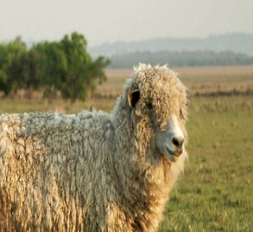
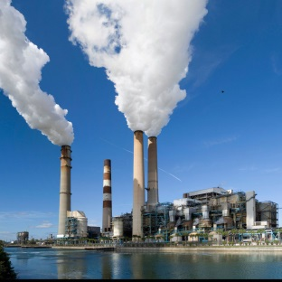
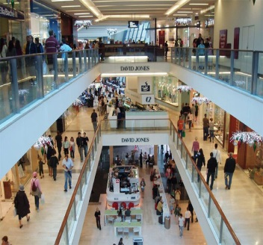
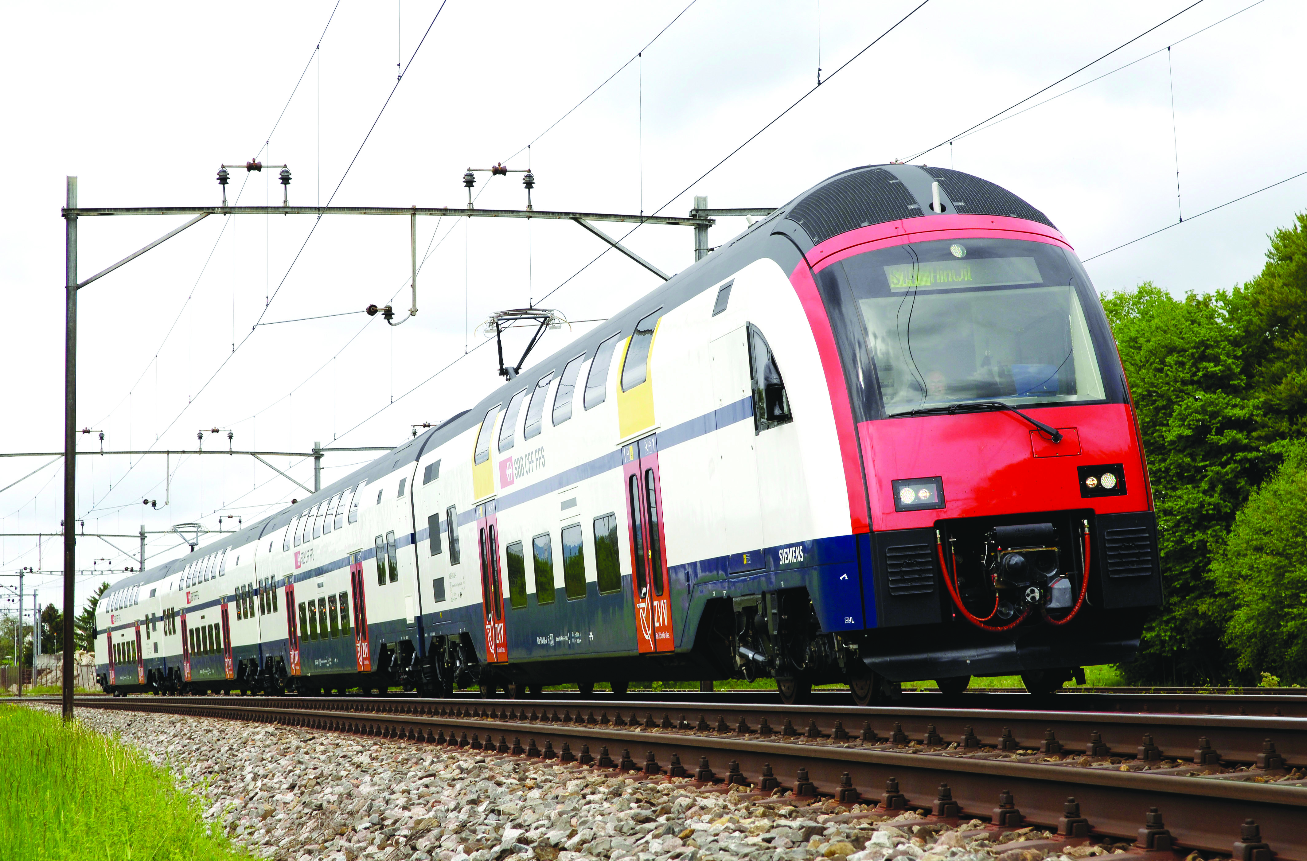
Types of society
Rural societies
Industrial societies
Post-industrial societies

Slide 3
Society →group of cooperation, to protect themselves and improve their quality of life
Clans and tribes
Villages and cities
States and empires
Organized to cover needs
Economic system
Political system
Laws

Slide 4
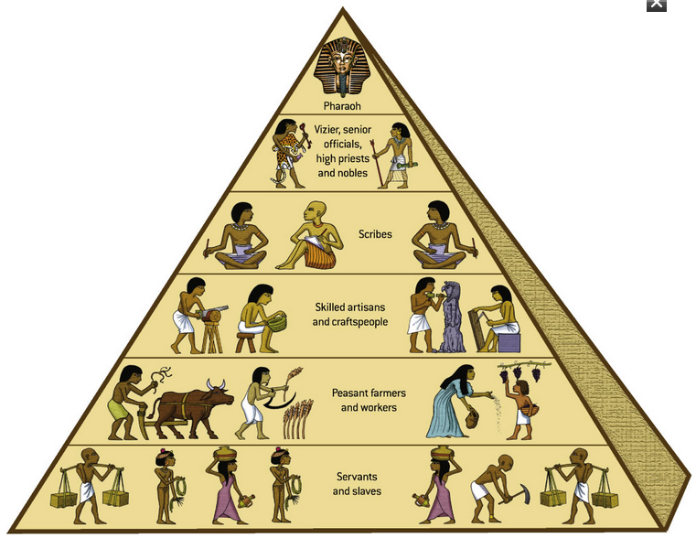
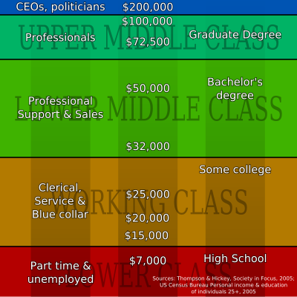
Social structure

Slide 5
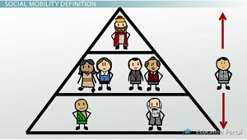
Static
Dinamic
Social mobility is a change in position within the social hierarchy

