Slide 1
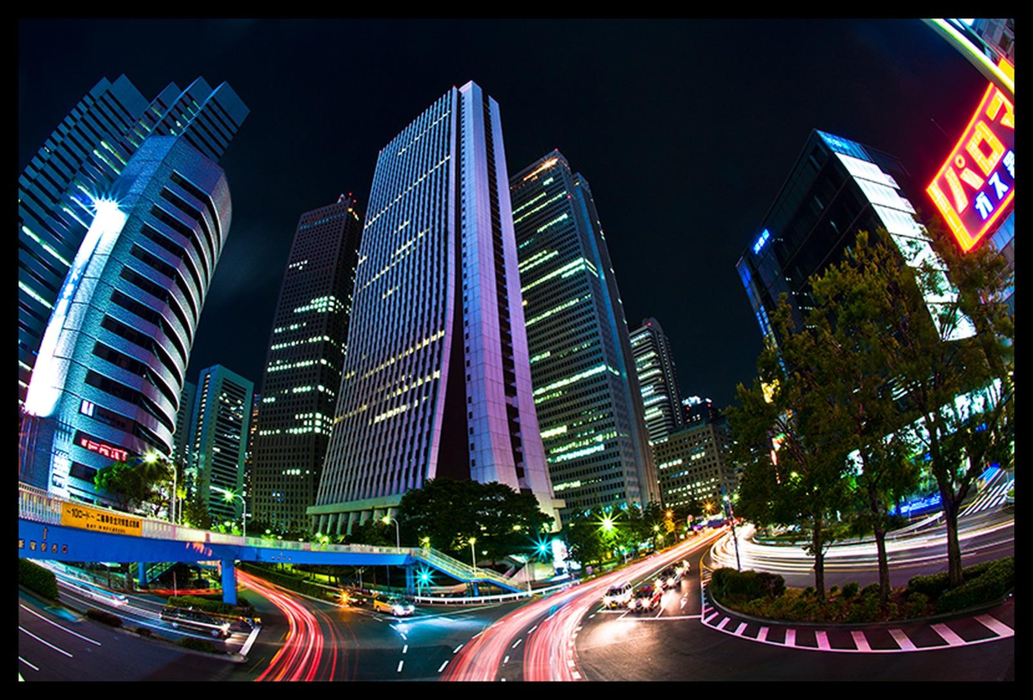
Unit 14
Rural and urban habitats

Slide 2
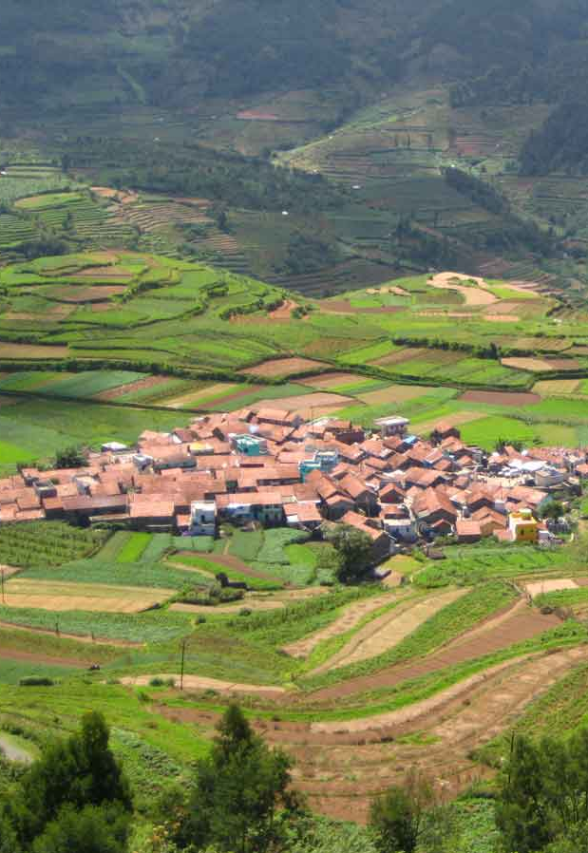
Scattered community
Concentrated community
Rural habitat

Slide 3
Irregular layout
Grid plan
Radiocentric layout
Regular layout
Urban habitats

Slide 4
City structure

Slide 5
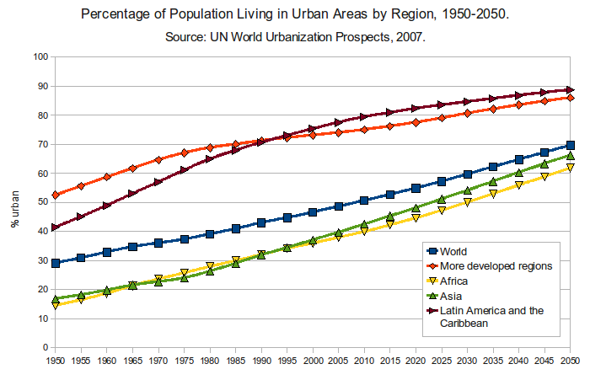

Slide 6
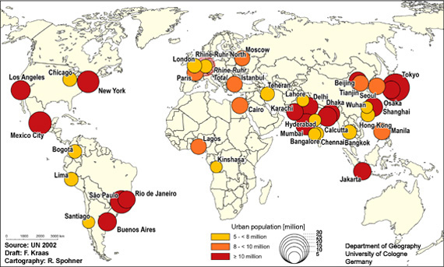

Slide 7
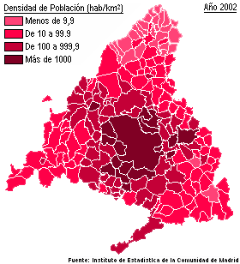
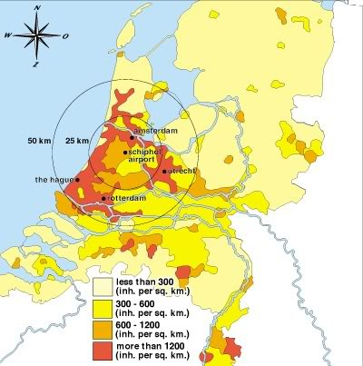
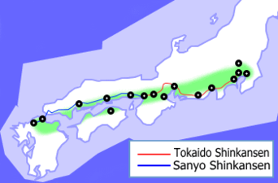
Metropolitan area
Conurbation
Megalopolis

Slide 8
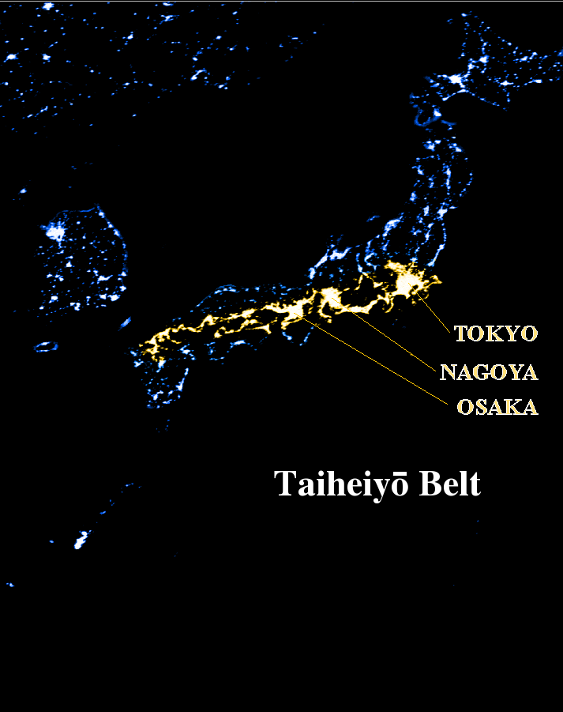

Slide 9
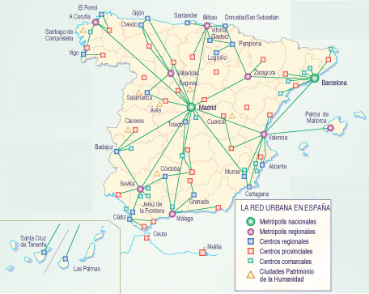
Urban network

Slide 10
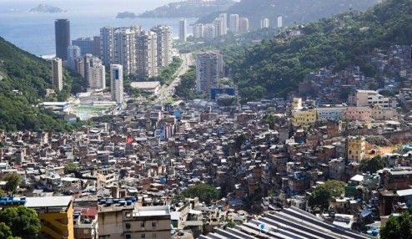
Cities in developing countries: Rio de Janeiro, Brazil

Slide 11
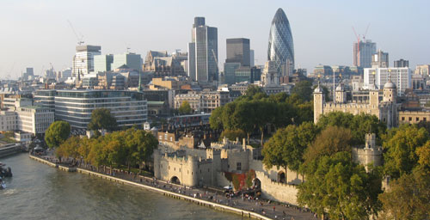
North American and Canadian cities
European cities

