Slide 1
Unit 5
Economic activity and work

Slide 2
1
Economic activity
Production
Distribution
Consumption
Material
Services
GOODS

Slide 3
Production
Natural resources
Biological
Mineral
Human resources
Workforce
Money
Sources of energy
Factories
Skills

Slide 4
Distribution
Transportations of goods to market
the producers (who offer) and the consumers (who demand)
the place where goods are traded

Slide 5
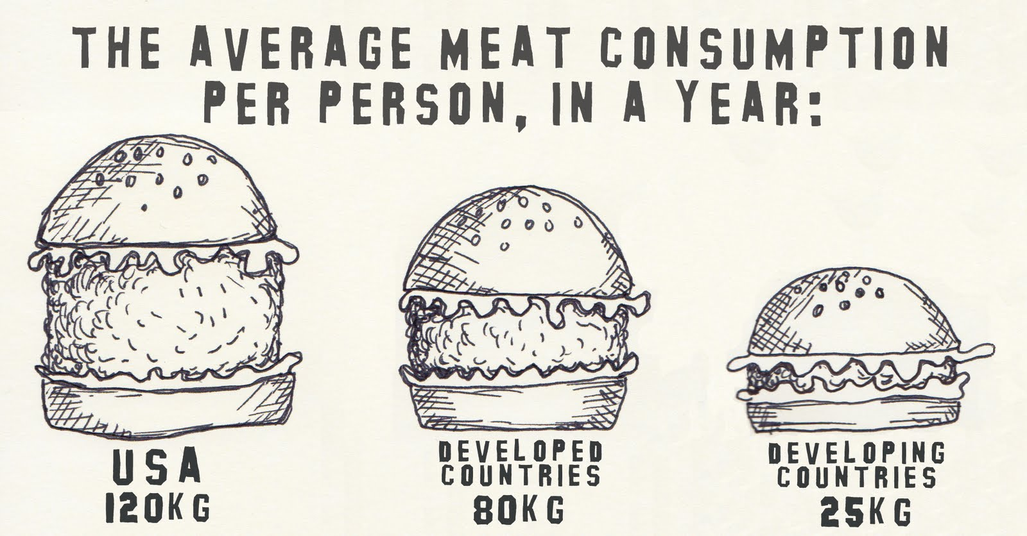
Consumption
Acquisition or use of the goods produced to satisfy human needs.

Slide 6
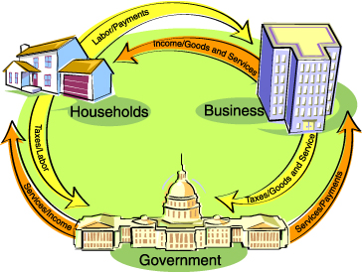
Economic agents
2

Slide 7
3
Economic systems
Different ways of organising and carrying out economic activity
The socialist system
The economic activity is organised by the State: planned economy
State: owner of companies and means of production. Decides what to produce, controls the distribution of goods, set the prices of products and salaries.
Objective: achieve social equality

Slide 8
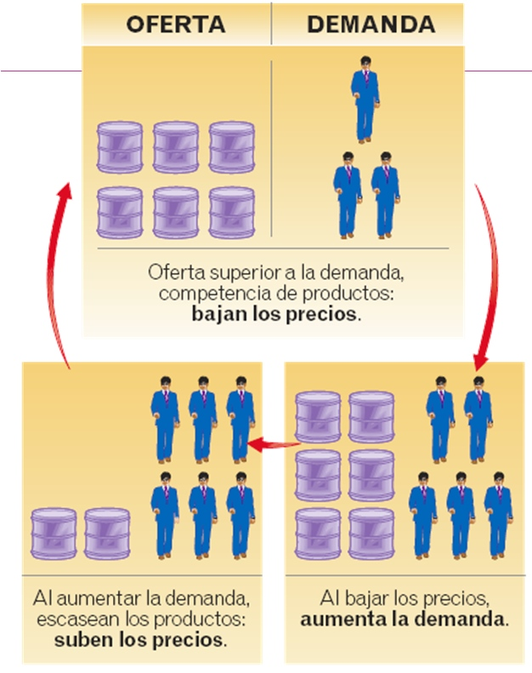
The capitalist system
The economic activity is regulated by the market: market economy
Private companies own the means of production.
The market sets the prices of products and salaries by means of the law of supply and demand.
The economy regulates itself
Objective: to achieve the maximun profit by means of free competition among companies

Slide 9
Changes in the capitalist system
Problems: economic crisis, situations of monopoly or oligopoly, social needs
Keynesian economists | Neoliberals economists
Intervention of the State in the economy | Liberalisation of the economic system
Public companies | Result: the globalisation of economy
Legislation and economic policy Granting assistance to families and companies

Slide 10
4
The globalisation of the economy
Globalisation: the growing integration of national economies in a worldwide market economy
Causes
The progress of telecommunications
The improvement of transport
The widespread adoption of the capitalist system and the use of neoliberal ideas

Slide 11
Many international groups and institutions promote the global economy. Multinational have also caused the spread of globalisation.
Production is organised on a worldwide scale
Consumption is made more uniform
The exchanges of goods, capital, services and information become universal

Slide 13
He watches
• NBL basketball via satellite TV — USA
• Friends — USA
• Home and Away — Australia
• The Bill — UK
• American and British movies
Plays
Plays basketball, loves skiing and snowboarding and hopes to complete a ski instructors’ course in Canada when he finishes the HSC
Listens to
• Metallica — USA
• Eminem — USA
• Ja Rule — USA
• Blink — USA
• POD — USA
• Grinspoon — Australia
Preferred fast foods
McDonalds and KFC — USA

Slide 15
She watches
• The Bold and the Beautiful — USA
• Friends — USA
• The Secret Life of Us — Australia
• Home and Away — Australia
• American and British movies
Plays
Practises martial arts, plays touch football and plans to go on a surfing holiday in Hawaii
Listens to
• Eminem — USA
• Red Hot Chilli Peppers — USA
• Craig David — USA
• Destiny’s Child — USA
• George — Australia
Preferred fast food
McDonalds

Slide 16
Are you a Global Teen?
What do you eat?
What do you wear?
What music do you listen to?
What sport do you play?
What technology do you use?

Slide 17
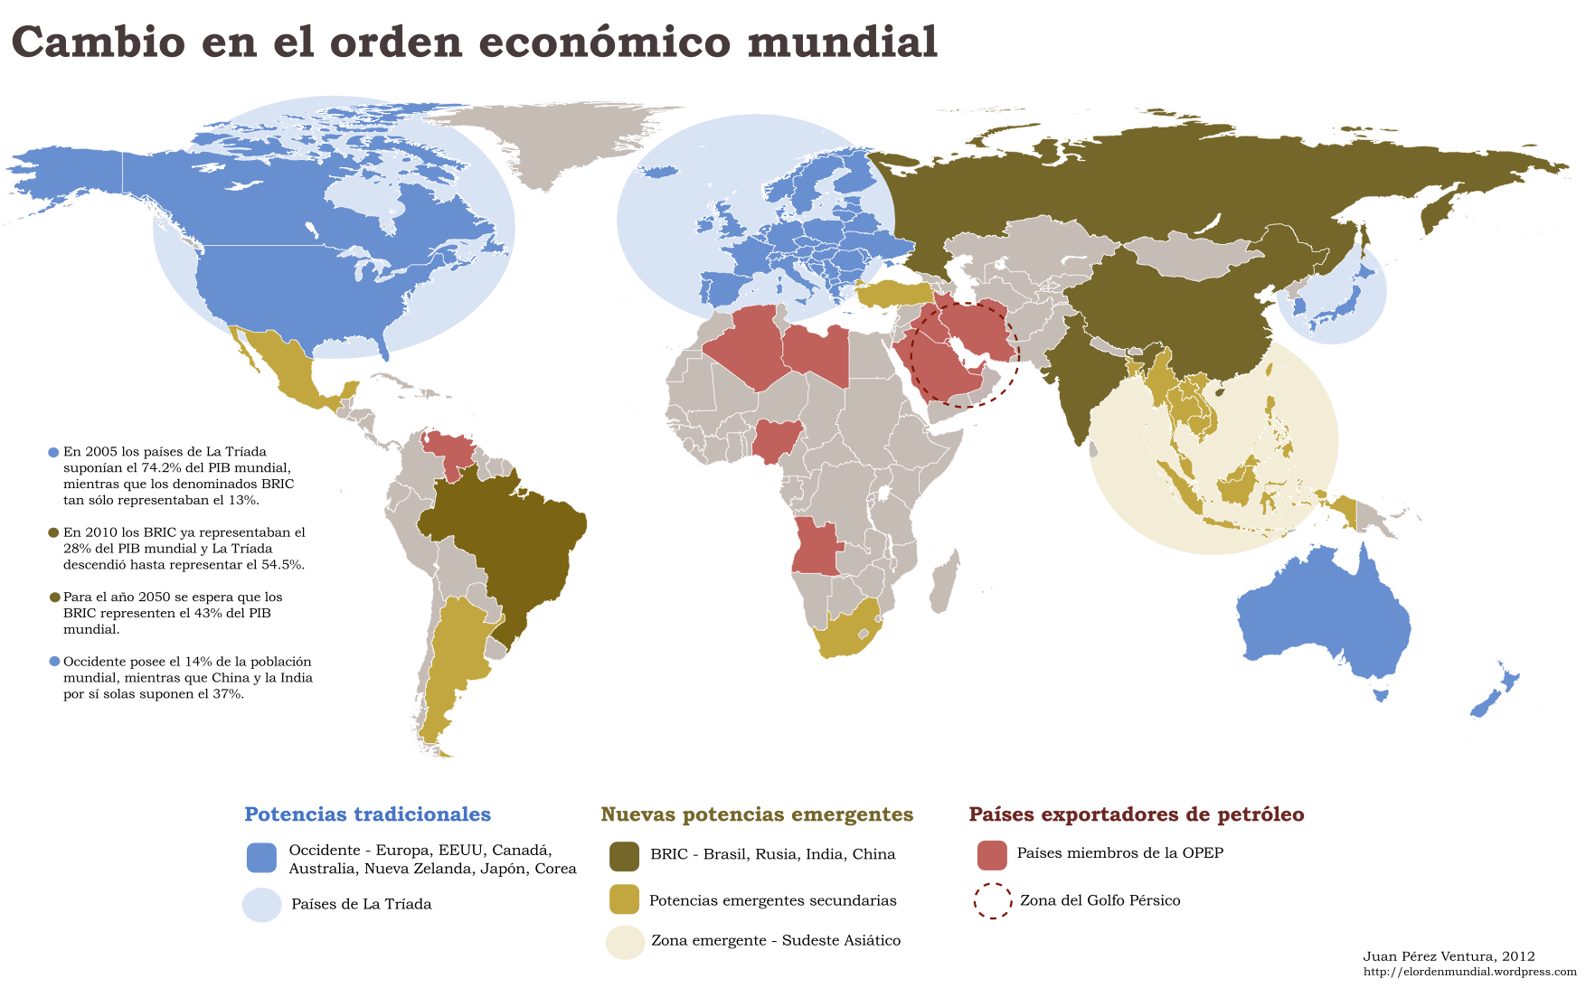
5
The geo-economic regions of the world

Slide 18
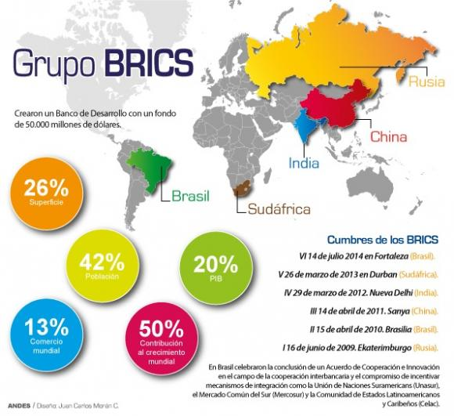

Slide 19
6
The world of work. The labour market.
Work: effort made by people in order to produce wealth.
Population
Active population
Occupied
Unoccupied
Inactive population
Pensioners, students, home-makers
Activity rate: % of active population compared to the total number of people of working age, at world level → 41%

Slide 20
Labour market: supply of work, offered by companies, and the demand for work by people
Qualified workers
Non-qualified workers
Changes
Globalisation
Increase in temporary contracts and part-time job
Increase in working from home
Problems
Unemploymet
Discrimination against women
Child labour

