Slide 1
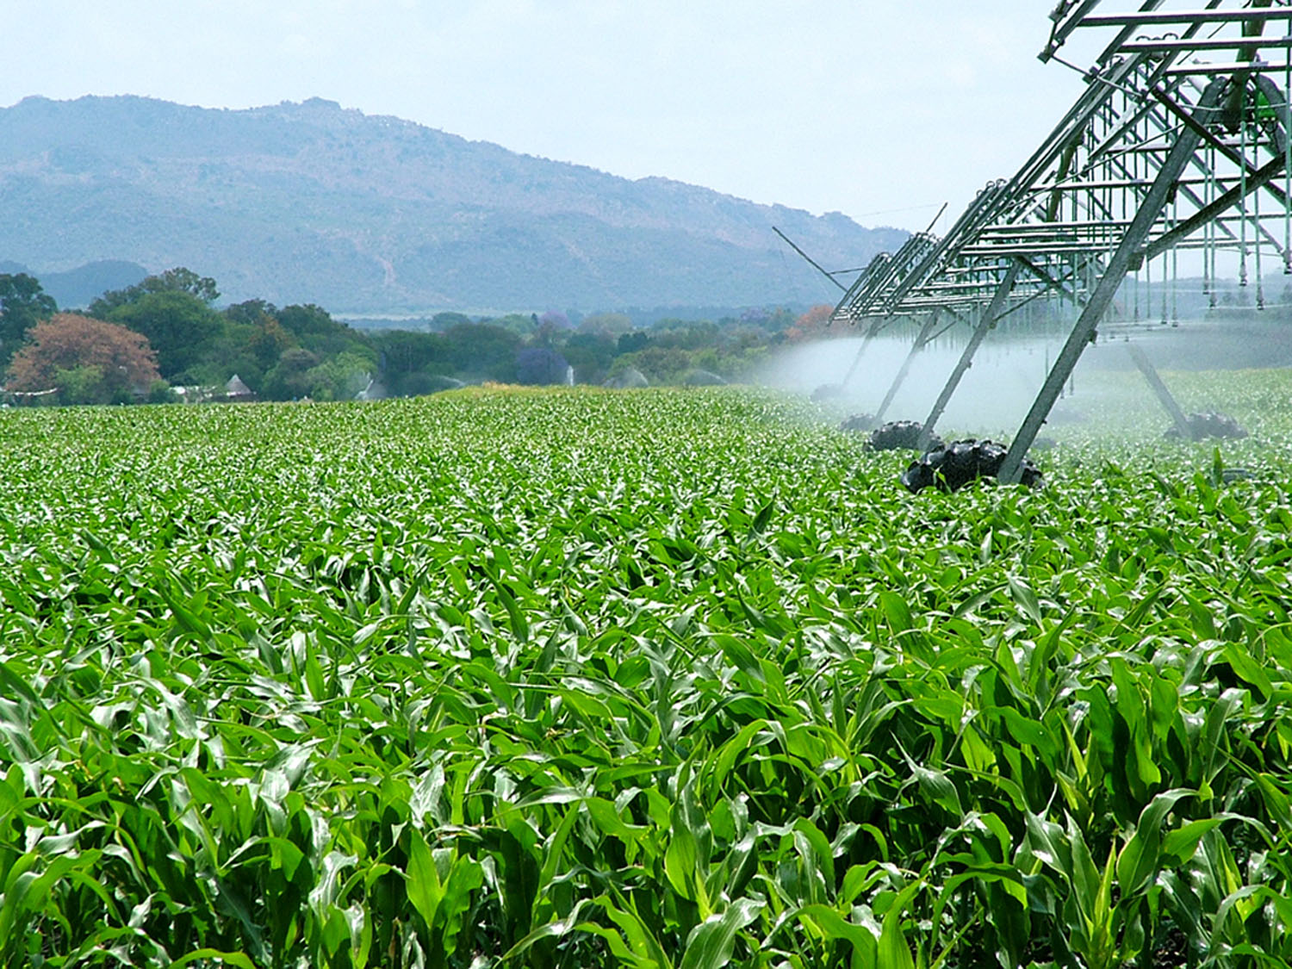
Unit 6
Primary sector activities

Slide 2
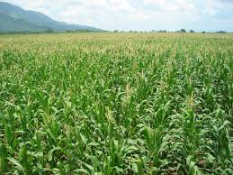
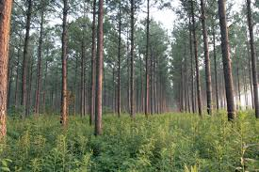
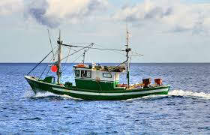
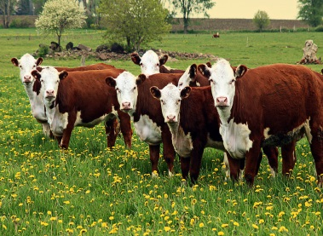
1. Agriculture
Primary sector: economic activities related to obtaining resources directly from nature.
Use land to obtain natural resources
Forestry: managing forests in order to obtain natural products
Agriculture: cultivation of land in order to obtain different kinds of plants
Livestock farming: breeding of animals in order to obtain products for human use

Slide 3
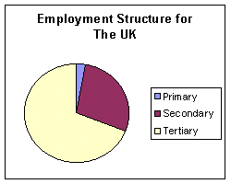
38,3% of the world’s population

Slide 4
2. Natural factors influencing agriculture
Climate
Soild and vegetation
Land relief
Flat land
Valley bottoms
Under a certain altitude
Temperature
Humidity
Light
Depth
Texture
Acidity

Slide 5
3. Human factors in agriculture
Population growth
Social and economic organisation
Technological progress
More space in needed-> deforestation
Agricultural economy: subsistence or market economy
Social organisation: ownership, size, production system.
Tools
Modify unfavourable natural conditions

Slide 6
4. Features of agricultural landscapes
Fields:
-Size: small/medium-size/large
- Shape: regular/irregular
-Limits: open/enclosed
Cultivation systems:
- Variety of crops: monoculture/polyculture
- Water the plants receive: dry farming/irrigation
- Use of the land: constant/rotation
- Working of the land: intensive/extensive
- Destination of the produce: subsistence/commercial
Settlement:
- Disperse
- Concentrated
- Intermediate

Slide 7
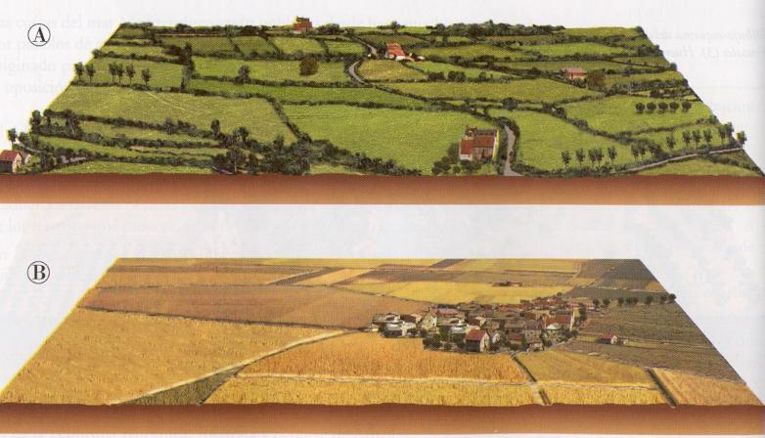

Slide 8
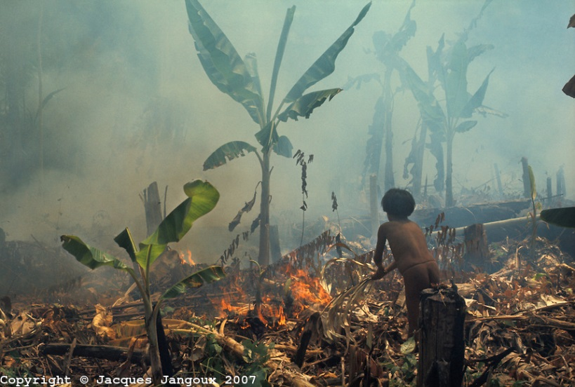
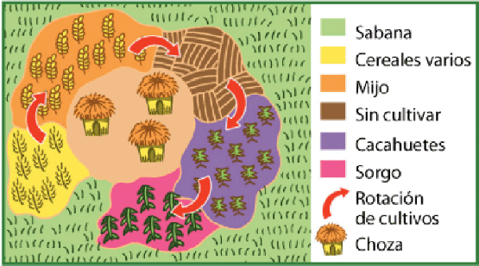
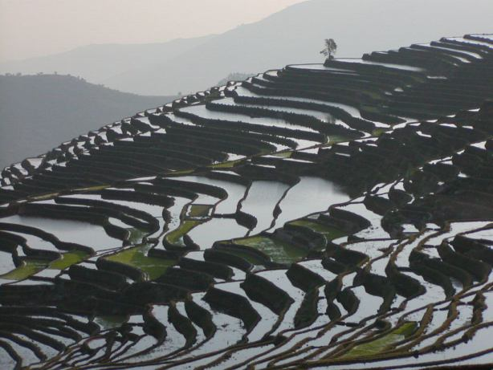
5. Traditional agricultural landscapes
Dry sedentary agriculture
Slash and burn
Monsoon irrigation agriculture

Slide 9
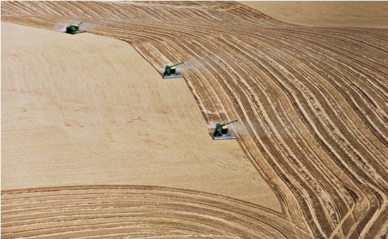
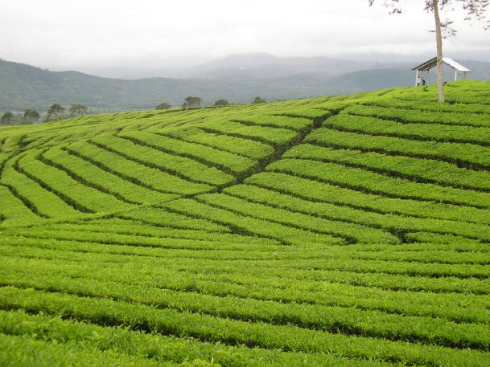
6. Developed agricultural landscapes
Farmers practice market argiculture, advanced technology and less intensive labur. Production is abundant and farmers specialise in the products best adapted.
New-world countries
Large, regular fields
Technology
Very little labour
Production massive and specialised
Plantation
Large, regular fields
Technology
Great deal of labour

Slide 10
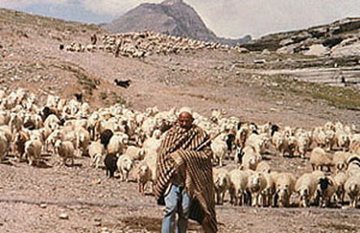
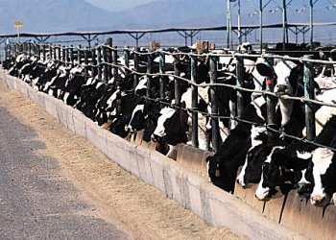
7. Livestock farming systems
Complement agriculture
2 functions
Livestock farming systems
Traditional livestock farming systems
Market livestock farming systems
Nomadic livestock farming
Transhumant livestock farming
Extensive livestock farming
Intensive livestock farming
Dominant activity

Slide 11
8. Fishing. Using the resources of the sea
Fishing is any activity which obtains natural products from the sea. It is used to obtain food and raw materials.
Where fish are abundant are called fishing grounds or banks.
Artisanal
Small boats and ships
Traditional techniques
Little labour
Industrial
Large factory ships
Modern technology
Great deal of labour
Intended for local market
Production abundant for sale on the domestic or international market

Slide 12
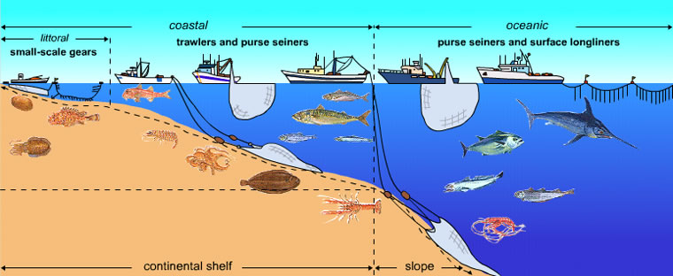
Coastal fishing
Offshore fishing
Deep-sea or high-sea

