Slide 1
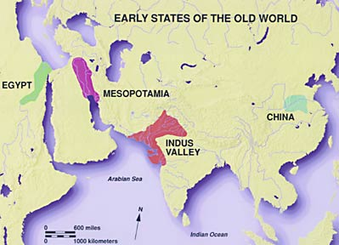
UNIT 9
Early civilizations

Slide 2
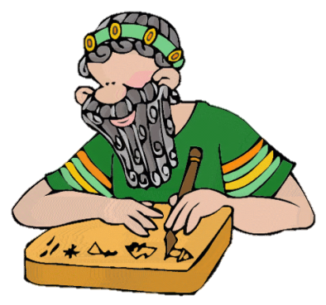
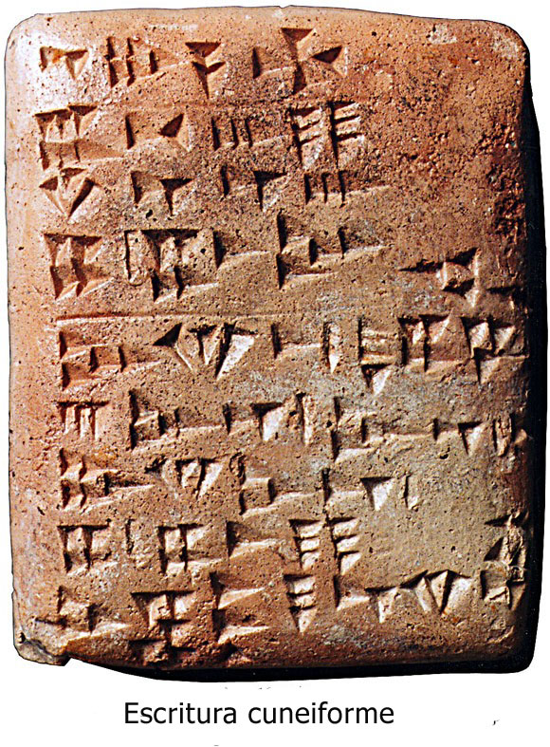
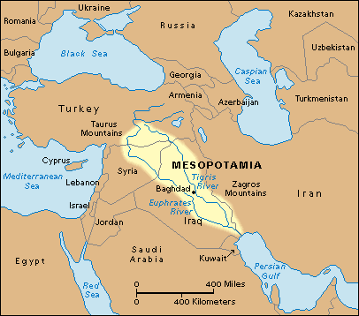
1. The invention of writing
Writing appears more than 5000 thousand years ago in Mesopotamia. It’s the start of History.

Slide 3
2. From cities, to Empires
First cities ruled by a king → big empires appear
River civilizations
Strong political power 8king)
Hierarchical society
Large-scale building
works
Mesopotamia
China
India
Egypt

Slide 4
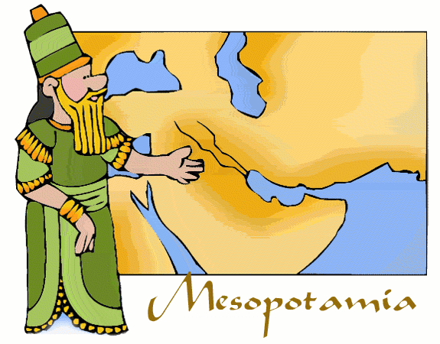

Slide 5
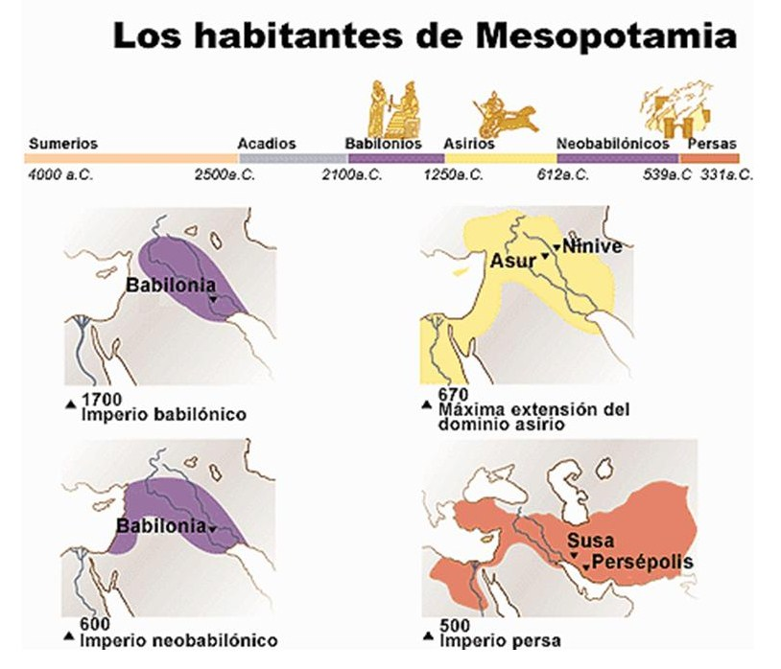
3. History of Mesopotamia
Mesopotamia = between rivers
Between the rivers Tigris and Euphrates
Dry area, but irrigation canals allowed the agriculture to develop
Key region for trade
Very long history: 3th millennium BC until VI century BC

Slide 6
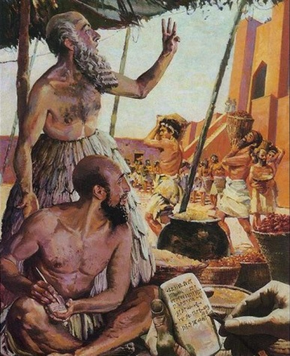
4. Population and work
Aristocracy
Peasants and craftsmen
Slaves
Priests
Civil servants (escribs)
Privileged groups
Freemen
Women

Slide 7
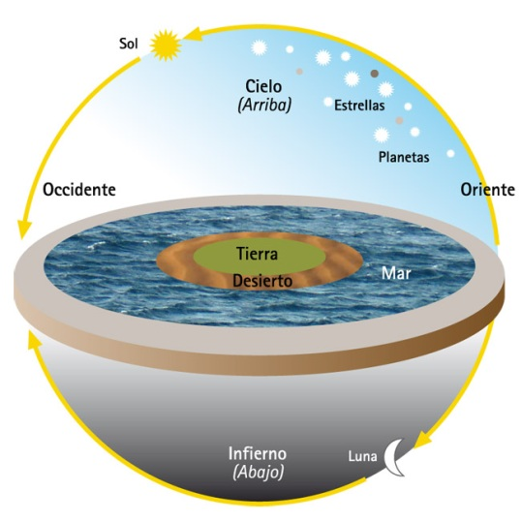
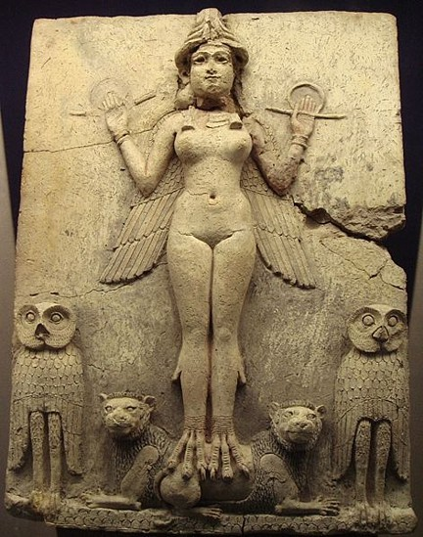
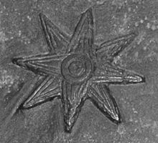
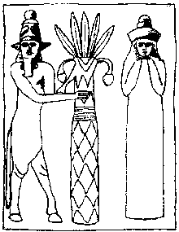
5. Mesopotamic culture
Religion
Polytheists
Ishtar
Enlil

Slide 8
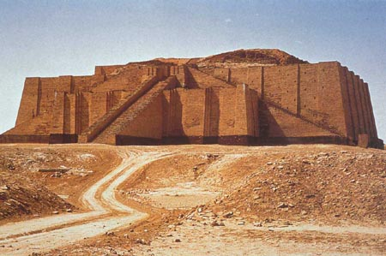
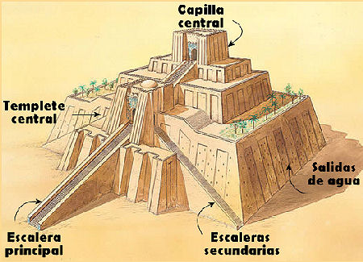
Architecture
They built with brick and e adobe
They use arches and vaults
ziggurats

Slide 9
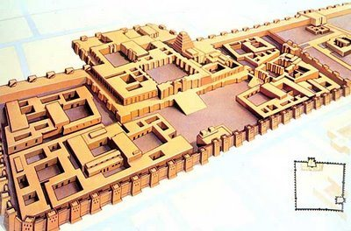
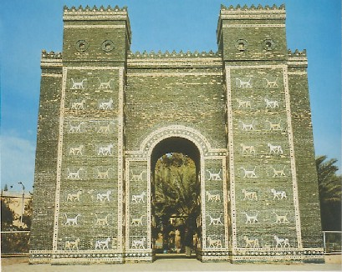
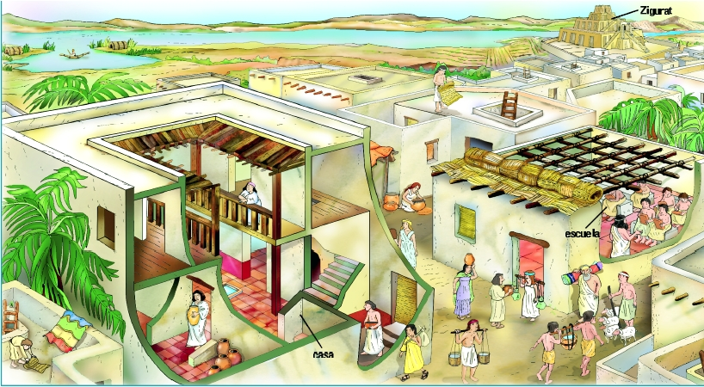
Palaces
Cities
With brick walls and four fortified doors

Slide 10
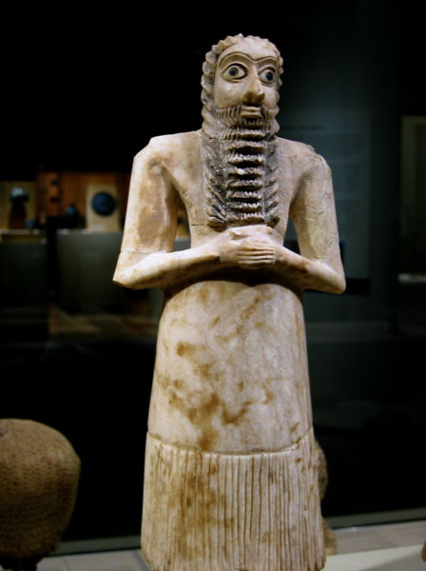
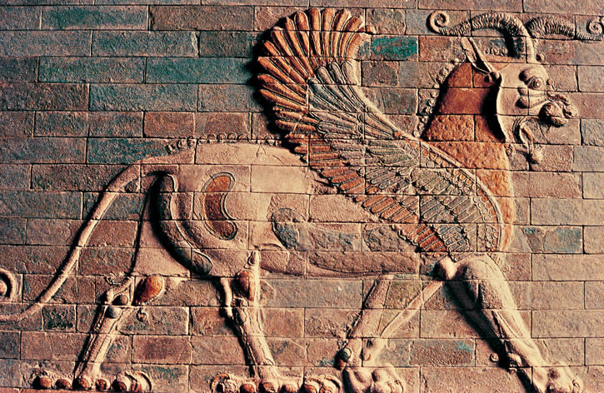
Sculpture
Statues : kings, gods or civil servants.
Reliefs: showed political and religious scenes

Slide 13
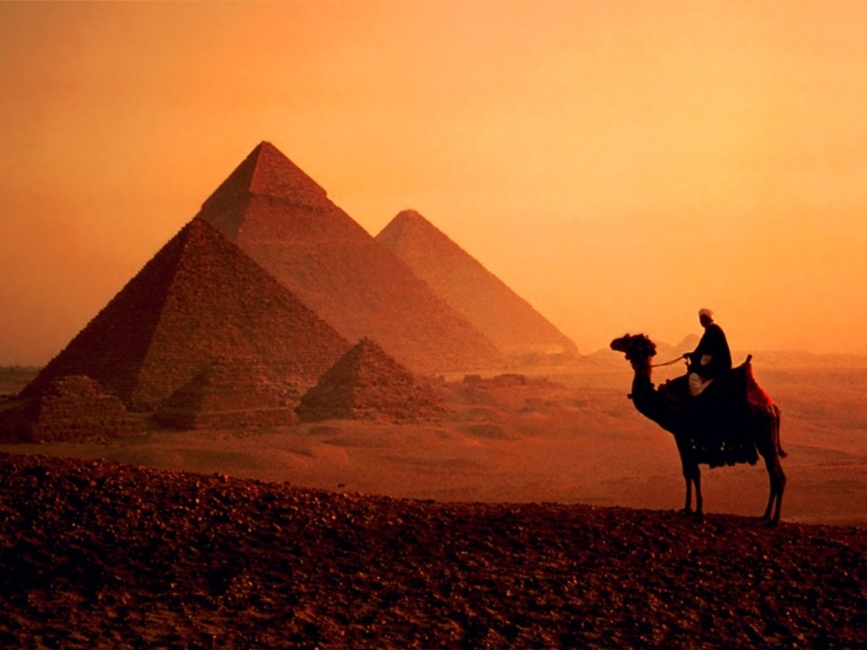
Ancient Egypt

Slide 14
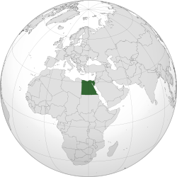
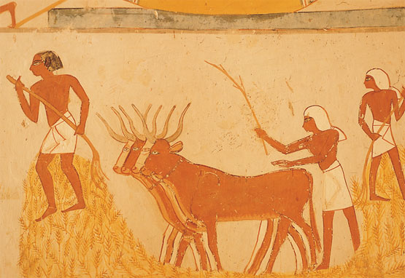
1. The country of the Nile
The overflows of the Nile
They built dams and canals
The Nile overflowed its banks once a year, flooding the river valley

Slide 15
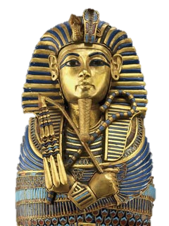
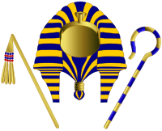
2. A pharaoh’s land
Egyptian civilization lasted about 3000 thousand years, from 3100 B.C to 31 A. C.
Ruled by kings: the pharaoh, he was all-powerful
They formed dynasties
They believed the pharaoh were gods and had magical powers
They lived surrounded by wealth, with slaves in big palaces

Slide 16
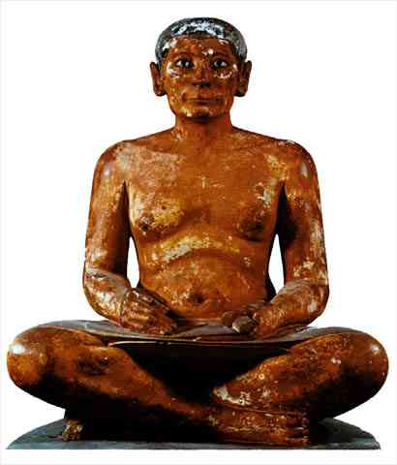
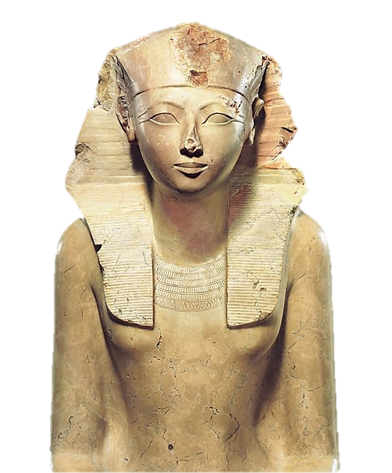
3. Society
Women
Enjoyed greater freedom than women in other civilizations
Privileged
Nobles
Scribes
Rest of the population
Peasants
Servants
Priests
Craftmen
Merchants
Slaves
Free
Without freedom

Slide 17
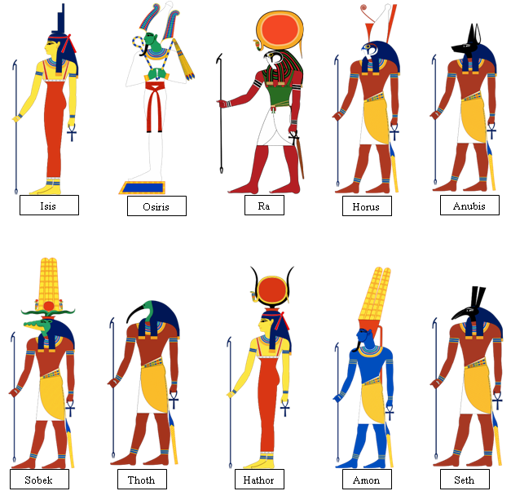
4. Religion
Polytheists
Religious rituals were necessary, every god had a temple and a group of priests. They made offerings to its statue.
They believed in the afterlife
Gods

Slide 18
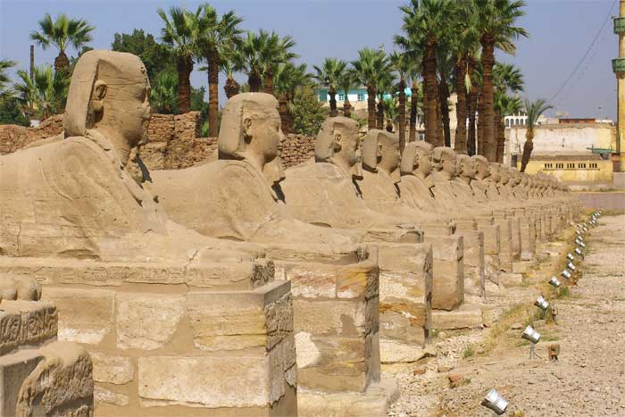
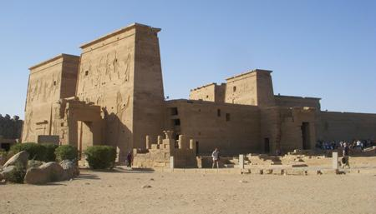
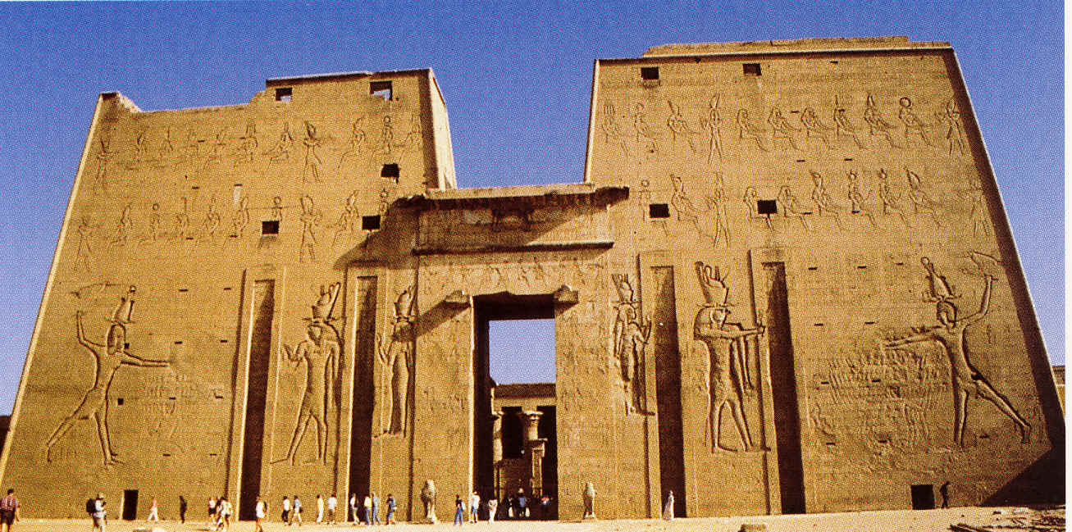
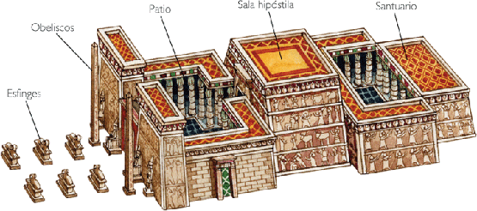
Temples
House of the gods
Built in stone
Big columns
Huge scale
Long avenue with sphinxes
Obelisks.
An open courtyard.
Hypostyle hall
Finally, the shrine

Slide 19
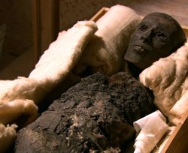
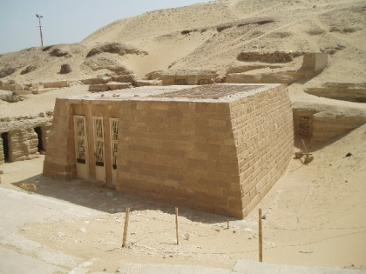
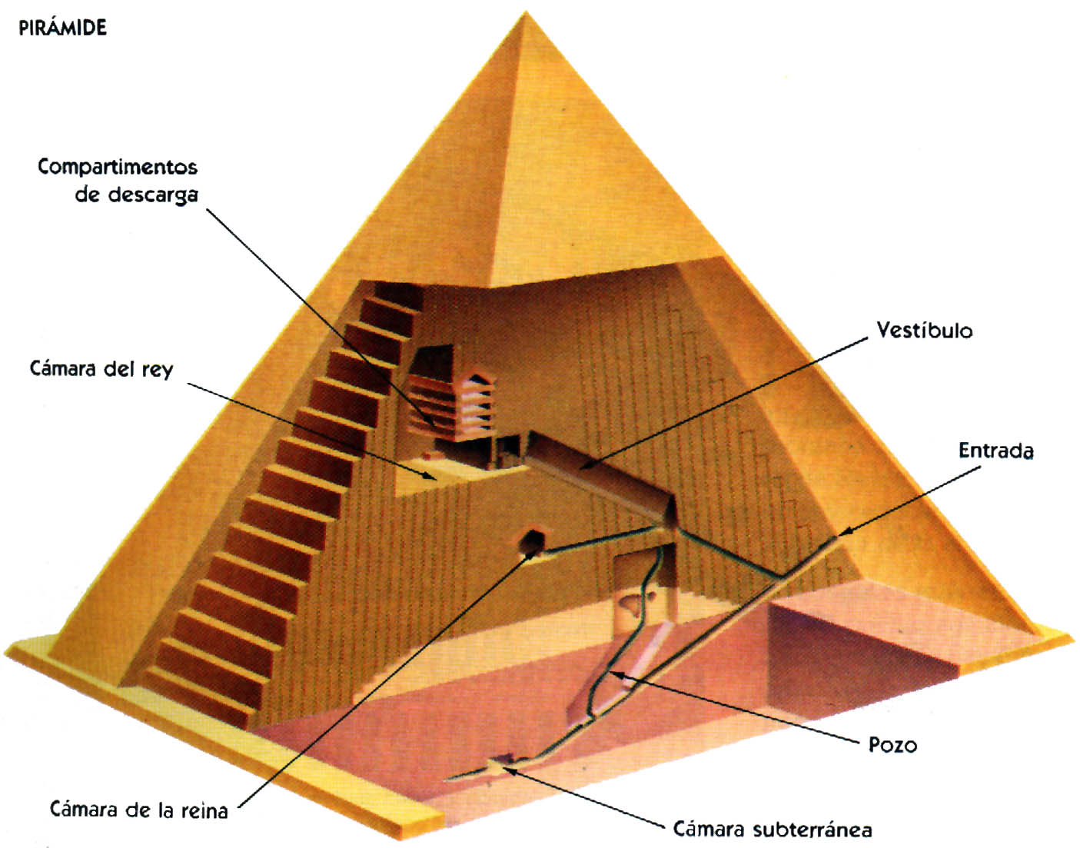
5. Afterlife. The tombs.
Dead bodies were dried to make mummies, and were put in sarcophagus.

Slide 20
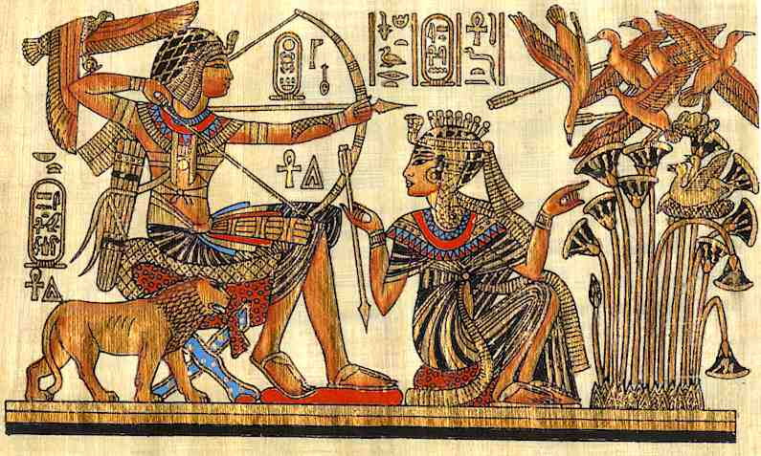
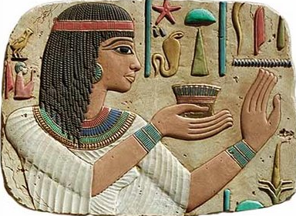
6. Art
Had a religious meaning.
A political meaning
Painting and sculpture
Changed very little because the artists followed very strict rules
Without perspective
Objects are seen from the
front.But heads, legs and
arms are in profile
The person is idealised
Static figures

