Slide 1
Weather maps

Slide 5
H

Slide 6
H

Slide 7
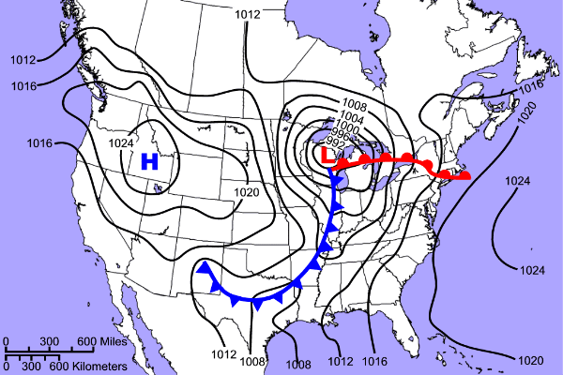

Slide 8
